Slide 1
New Summer Term Structure Effective 2020

Slide 2
Old Structure
Four distinct terms
Summer 1 (3-week)
Summer 2 (5-week)
Summer (10-week)
Summer 3 (5-week)
Billing, withdrawals, refunds, enrollment status based on individual term, not the entire summer
Multiple issues with financial aid & billing
Students charged term-based fees each term
Courses could be scheduled with same section number in different summer terms

Slide 3
New Structure
One term
7 sessions within the single term
Billing is based on the one long term (no term-based fee will be charged more than once)
Financial aid applied to the term as a whole
Payment deadlines for entire term
Each session will have its own withdrawal refund schedule, however the determination of a withdrawal is based on the enrollment across the one long term
Course sections have to be unique across the term (cannot have the same section number in multiple sessions)

Slide 4
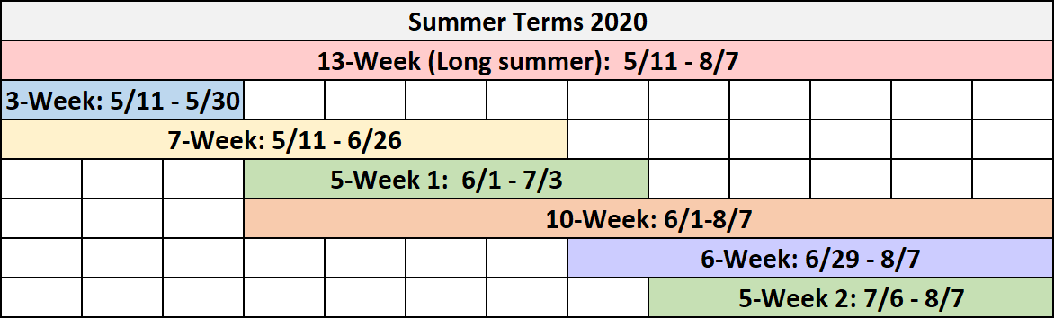
Session Structure & Sequence
https://twu.edu/media/documents/registrar/Summer-2020---Sessions-Grid.pdf
(www.twu.edu/registrar/academic-calendars/)

Slide 5
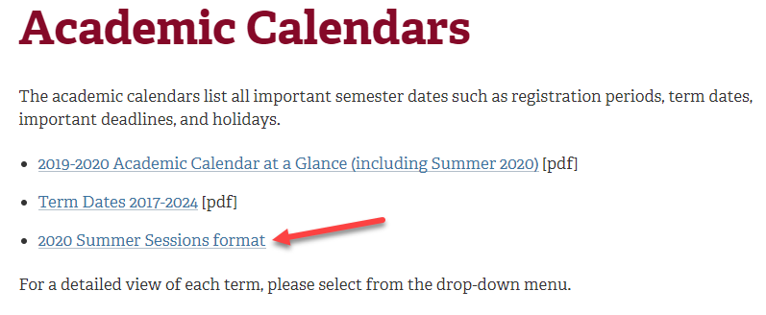
twu.edu/registrar/academic-calendars

Slide 6
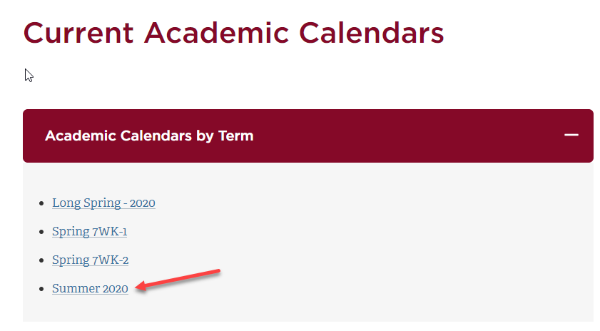
twu.edu/registrar/academic-calendars

Slide 7
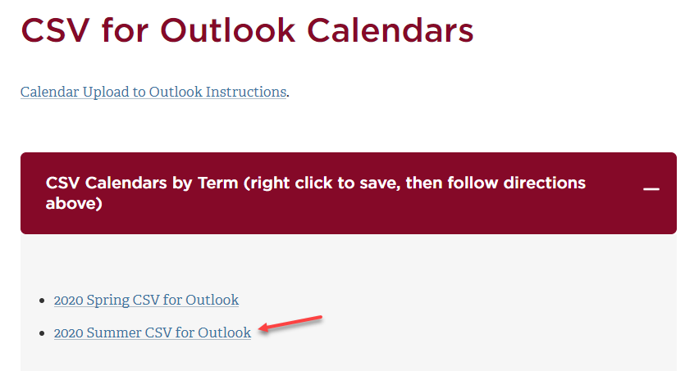
twu.edu/registrar/academic-calendars

Slide 8

Self-Service Course Catalog
Students & Faculty will be able to filter by Session under “Course Types”:

Slide 9
Self-Service Course Catalog
Every course section in Summer will display the session information:

Slide 10
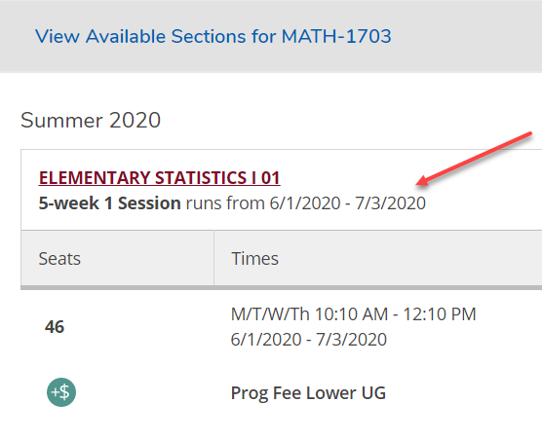

Slide 11
Registration
Registration dates will continue to be based on the session
Each session will have its own registration deadlines just as each term did in the past.
Example:
A student will be able to register for the 5-Week 2 from the opening of early registration until Friday, July 3rd with no additional fees, and from Saturday, July 4th until Tuesday, July 7th with an additional late registration fee.

Slide 12
Drops & Withdrawals
Drop & Withdrawals will be both term & session based
Term-based for the purposes of defining whether a course drop is a withdrawal or not.
Session-based for the purpose of refund deadlines and amounts

Slide 13
Refundable Drops
Determination of drop vs. withdrawal is based on the entire TERM enrollment
Refund deadline for a dropped course is based on the SESSION
(Texas Education Code, Chapter 54, §54.006)

Slide 14
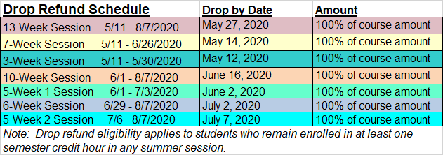
Source: TWU Bursar
(Texas Education Code, Chapter 54, §54.006)

Slide 15
Withdrawals
Determination of withdrawal is based on the entire TERM enrollment
Refund deadline & amount of the withdrawal based on the SESSION
(Texas Education Code, Chapter 54, §54.006)

Slide 16
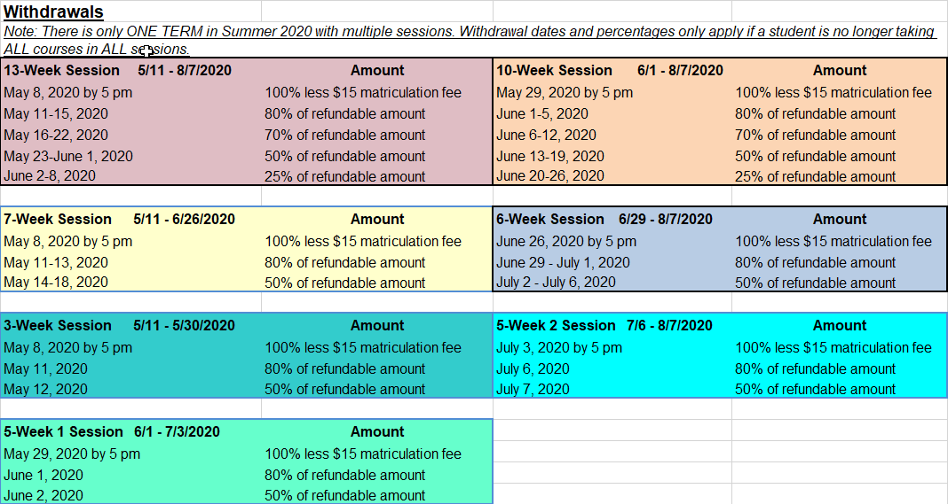
Source: TWU Bursar

Slide 17
Sample Scenario
Jill is registered for a 5-week 1 (old Summer 2) course and a 5-week 2 course (old Summer 3).
She decides to drop the 5-week 1 course on the 2nd class day, but remain enrolled in the 5-week 2 course.

Slide 18
Sample Scenario
2019: Jill would receive a 50% refund for dropping the course, because it would be considered a term withdrawal from the Summer 2 term, even though she is still enrolled in Summer 3.

Slide 19
Sample Scenario
2020: Jill would receive a 100% refund for the 5-week 1 course because it is considered a drop by the deadline rather than a term withdrawal.

Slide 20
Payment Deadlines
The total number of payment deadlines resulting in schedule deletions has been reduced from 9 in previous years down to only 5.
2019
2020
May 10
May 14
May 28
May 31
June 4
June 6
July 2
July 5
July 9
May 12 (3-wk end of late reg)
May 14 (13 & 7-wk end of late reg)
June 4 (10-wk end of late reg)
July 2 (6-wk end of late reg)
July 9 (5-wk 2 end of late reg)

Slide 21
Grading
Each session will still have its own grading period & deadline (13-wk, 10-wk, 6-wk, & 5-wk2 will have the final term grading deadline).
Grades will be verified after each session’s grading deadline to lock submitted grades in before the next session grading period opens.
Cumulative stats (att hrs, compl hrs, GPA, grade points, academic standings) will only be tabulated at the end of the long term (no different from before).

Slide 22
Grading Deadlines
3-week: Monday, June 8th
7-week: Monday, July 6th
5-week-1: Monday, July 13th
13-week, 10-week,
6-week, & 5-week-2: Monday, August 10th

Slide 23
Summary
Single term eliminates the charging of term-based fees multiple times throughout the summer.
Once a student is set-up on the payment plan, they are protected for the entire term regardless of the registration changes that may take place for later sessions.
Financial aid processing based on the overall single term will prevent past issues of aid not being applied correctly to different term bills.

Slide 24
Summary
Students will receive larger refunds for dropping a course in a single session than in the past.
Students will not have to go through cumbersome withdrawal process if dropping a single course in a session as long as they are enrolled (or completed) at least one course in any other summer session.
Payment plan option available for all of summer now rather than just for the long term/session.
Should result in fewer students being dropped for non-payment after term starts and fewer reinstatement requests.

Slide 25
QUESTIONS?

