Slide 1
Small Decisions… … Big Impacts

Slide 2

Office of the Registrar
https://twu.edu/registrar/resources/
Jenna Lee
University Registrar
jlee11@twu.edu

Slide 3
Office of the Registrar
Custodian of Official Academic Records
Registration
State of Texas Exemptions and Waivers
Residency
Enrollment Certifications
Transcripts
VA & Hazelwood Benefits
Graduation Certification

Slide 4
Online Services
Request official transcripts & view unofficial transcripts
View and print schedule
Change Address
Register for classes
Apply for graduation
Check grades

Slide 5
Grades
Students can access their grades online through Self-Service 24-hours a day
Grades are usually available the Tuesday after final exams

Slide 6
Record Security
FERPA: Family Educational Right and Privacy Act
Parents can view student’s record only with written signed consent from the student or by providing proof of dependency (most recent tax return)
Withhold Directory Information
Directory information is listed in the online student handbook, university catalog and at twu.edu/registrar

Slide 7
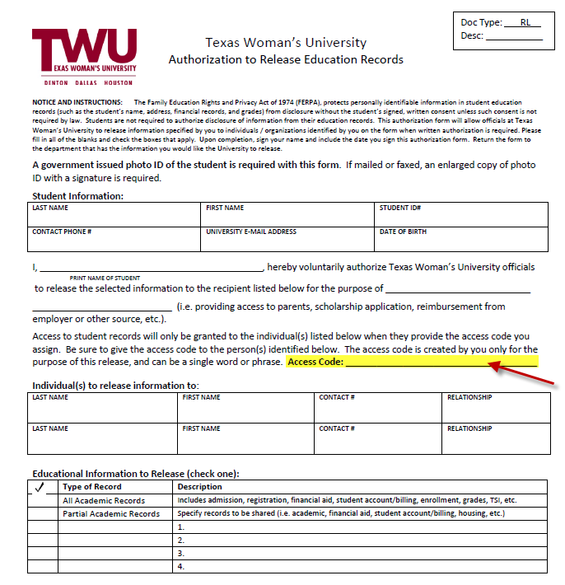
Release Form

Slide 8

Easy Tips for Success
Check TWU E-mail frequently
Links at bottom of every TWU webpage, in Pioneer Portal and in WebAdvisor
Double-check schedule in Student Planning
Registered: GREEN Planned: YELLOW

Slide 9
Easy Tips for Success
Refer to the Academic Colander often
Link in WebAdvisor: Academic Calendars and Catalogs
Accessible from any TWU webpage through Index
Deadlines & Registration Periods
Payment, Drop/Add, Withdrawal
All important “Census Date”

Slide 10

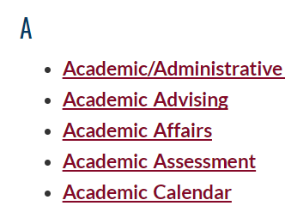
Academic Calendar

Slide 11
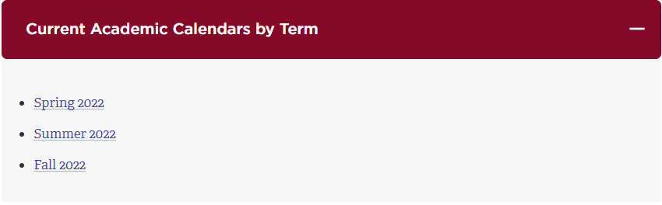
Academic Calendar

Slide 12
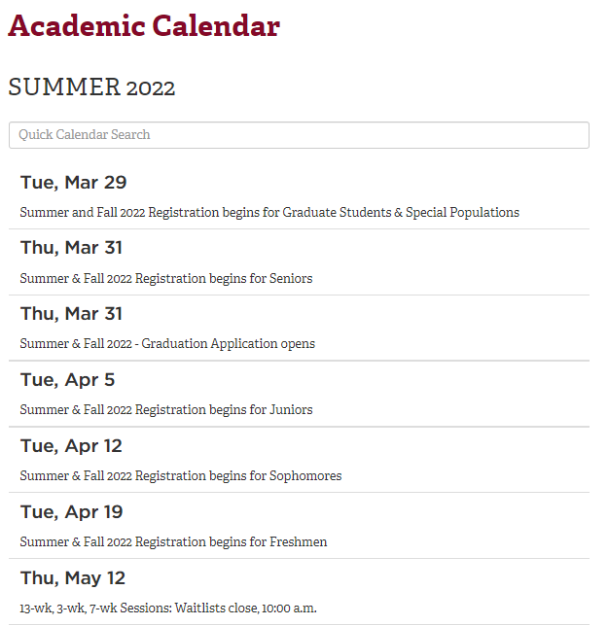

Slide 13


Slide 14
Important Texas Legislation Regarding Timely Completion of Degree
Excess Hour Rule
Six-Drop Limit
$1,000 Tuition Rebate Program

Slide 15
Excess Hours
Excess hours are the number of semester credit hours over a student’s minimum degree requirements (double-major and dual degree hours are considered)
30-Hour Rule: Undergraduate students who enrolled initially in the fall 2006 semester or subsequent semesters cannot exceed more than 30 hours.
Students with excess hours will be charged an additional tuition rate per semester credit hour.
Applies to all Texas residents and those students who are non-resident students paying in-state tuition rates with excessive hours.
Include all transfer work taken from any Texas public institution plus all TWU hours taken through the semester prior to the registration term.
Excludes developmental, dual credit, credit-by-exam, & vocational/technical courses. Hours earned by the student at a private institution or out-of-state institution do not count towards excess hours.

Slide 16
Six-Drop Limit
Legislative mandate.
Students enrolling in higher education for the first time during the fall 2007 academic term or any term subsequent to the fall 2007 term may drop a total of six courses.
Drop total includes any course a transfer student has dropped at another Texas public institution of higher education.
Does not apply to courses dropped prior to the census date or courses dropped with a grade of WF and does not apply if the student withdraws for the term or session.
Exemptions do exist.
What happens after six drops? Grade assigned as earned.

Slide 17
$1,000 Tuition Rebate
A few of the major rules:
Attempted no more than 3-hours in excess of the minimum degree requirements.
Always been entitled to pay Texas resident tuition.
Notify TWU of intention to apply for the $1000 Rebate in the graduating semester.
Beginning Fall 2005 new students must graduate in 4-years.
www.twu.edu/registrar/tuition-rebate-plan.asp

Slide 18
Privacy of Educational Records
It is a violation of federal law (FERPA) to release student educational information without student consent
All faculty are required to take mandatory FERPA training through Canvas.
Instructions available at
https://twu.edu/registrar/family-educational-rights-and-privacy-act-ferpa
Never post grades by name, ID, or SSN.
Notes:
Starter Slide.

Slide 19
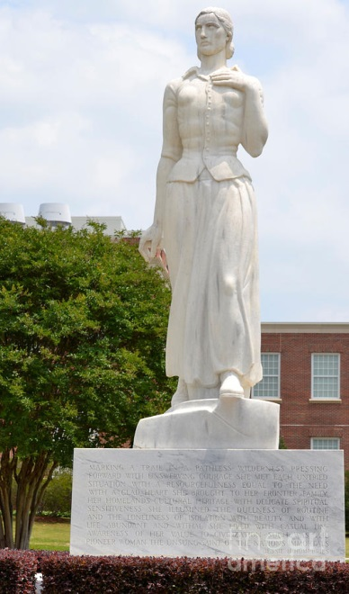
Questions?
Jenna Lee
University Registrar
jlee11@twu.edu
940-898-3735
Office of the Registrar
GRB 230
940-898-3036
registrar@twu.edu
www.twu.edu/registrar
Notes:
Starter Slide.

