Slide 1
Office of the Registrar New Graduate Teaching Assistant Orientation

Slide 2

Office of the Registrar
https://twu.edu/registrar/resources/
Jenna Lee
University Registrar
jlee11@twu.edu

Slide 3
Office of the Registrar
Academic Calendar
Course Rosters
Early Alert
Grading
Student Privacy

Slide 4
Academic Calendar

Slide 5
Academic Calendar
Registration Dates (no new registrations after Late Registration period)
Term dates & deadlines
Census Date (all enrollment after census day is official & counts as attempted hours)
Add/Drop/Withdraw Deadlines
Grading period dates and deadlines

Slide 6

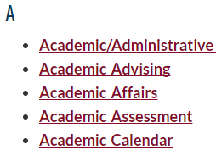
Academic Calendar

Slide 7
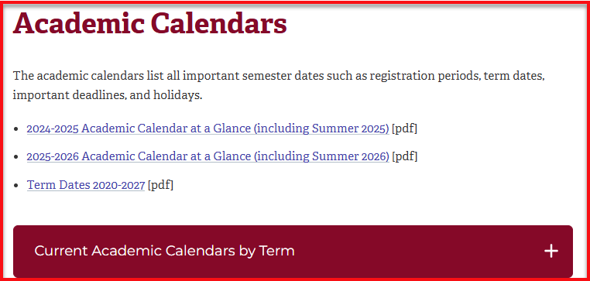
For a detailed view of each term, please select from the Current Academic Calendars by Term list

Slide 8
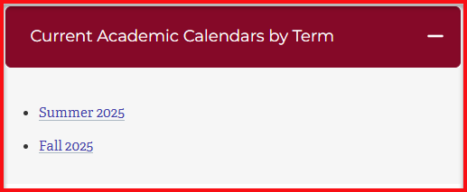

Slide 9
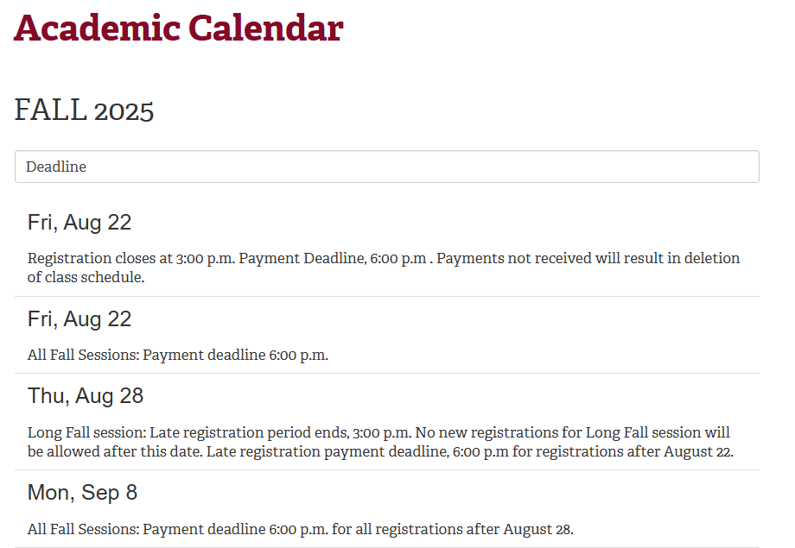

Slide 10
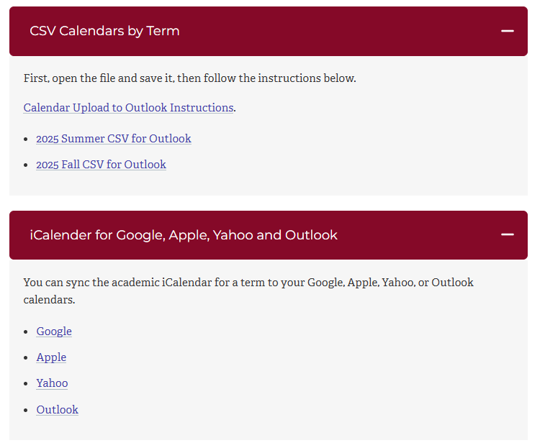

Slide 11
Class Rosters,
Early Alert,
& Grading

Slide 12
Class Rosters & Grading
All rosters and grade submissions are done online through Faculty Self-Service:
Go to selfservice.twu.edu
Log in using your TWU username & password (userame must be in all lower-case)
Click on “Faculty” menu item

Slide 13
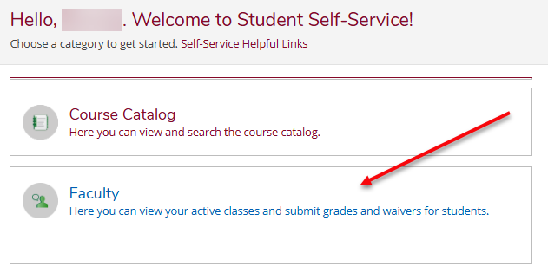
Faculty Self-Service

Slide 14
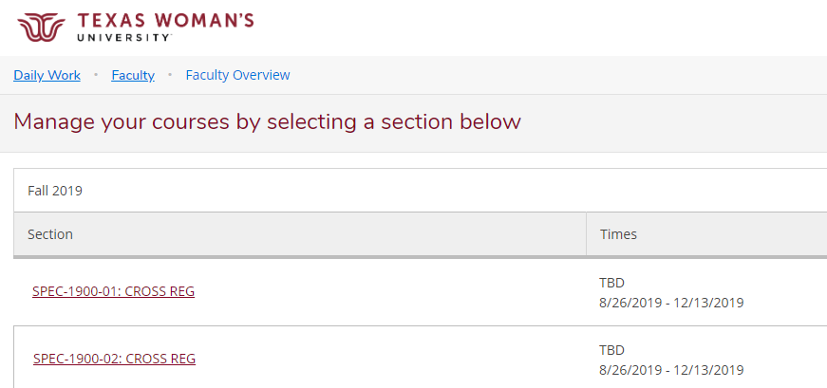
Faculty Self-Service
Notes:
Starter Slide.

Slide 15
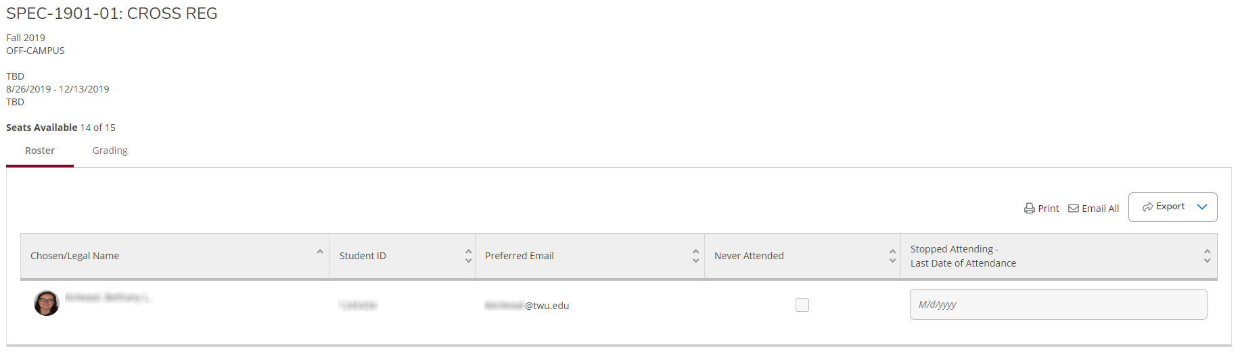
Faculty Self-Service
Notes:
Starter Slide.

Slide 16
Class Roster
Real-time list of currently enrolled students
Attendance should be checked against the roster on first class day and every subsequent class day through the census date
Students not on roster who are attending and think they are enrolled need to:
During Late Registration: Register themselves through WebAdvisor if eligible
After Late Registration: Need department approved Add form submitted to Registrar’s Office
Notes:
Starter Slide.

Slide 17
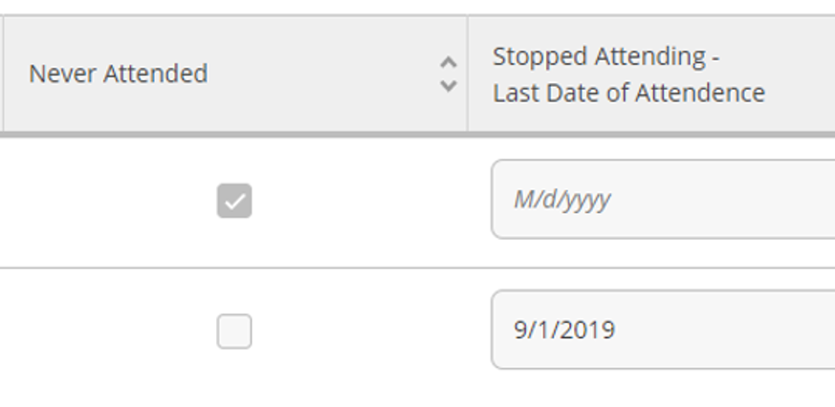
Class Roster – Post Census Date
When known, utilize interactive rosters in Self-Service to indicate if a student has “Never Attended” or “Stopped Attending” (indicate with date)
Notes:
Starter Slide.

Slide 18
Early Alert
At the beginning of the 5th week, instructors of freshmen or sophomores will be asked to submit the status of students in danger of failing the course (current grade of D or F)
Critical early intervention for high risk students
Early Alert please see the Academic Calendar for dates
Utilize Early Alert menu item in WebAdvisor
Notes:
Starter Slide.

Slide 19
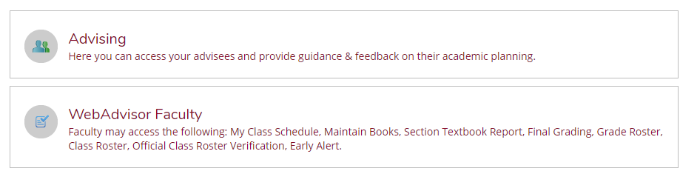
Early Alert
Notes:
Starter Slide.

Slide 20
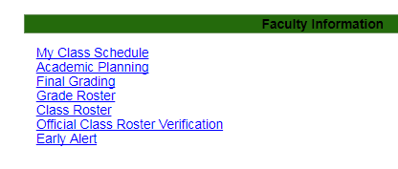
Early Alert
Notes:
Starter Slide.

Slide 21
Final Grading
Final grading is opened the week prior to final exams and remains open until 5:00 p.m. the Monday after final exams
Fall 2025 grade deadline: Monday, December 15th, 5:00 p.m.
All enrolled students must have a grade submitted, even if they have not been attending.
Grades not submitted by the deadline will require a “Change of Grade” form signed by the instructor and the department chair for each missing grade.
If you have difficulties, please contact the Registrar’s Office PRIOR to the deadline for assistance.
Notes:
Starter Slide.

Slide 22
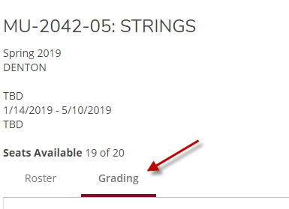
Final Grading
Notes:
Starter Slide.

Slide 23
Class Rosters & Grading
The Registrar’s Office will send out notifications to faculty TWU e-mail addresses at the opening of each grading period
Notifications will include the grading period deadline and detailed instructions.
Information is also available on the Registrar’s Office website at www.twu.edu/Registrar
Notes:
Starter Slide.

Slide 24
Student Privacy Rights &FERPA
Notes:
Starter Slide.

Slide 25
Privacy of Educational Records
It is a violation of federal law (FERPA) to release student educational information without student consent
All faculty are required to take mandatory FERPA training through Bridge.
Instructions available at https://twu.bridgeapp.com/learner/courses/cc9deb5c/enroll.
Never post grades by name, ID, or SSN.
Notes:
Starter Slide.

Slide 26
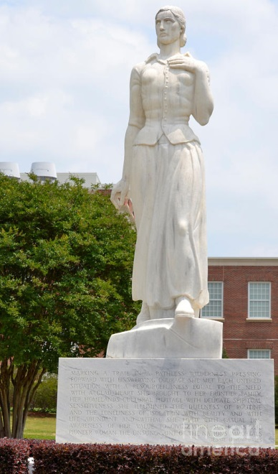
Questions?
Jenna Lee
University Registrar
jlee11@twu.edu
940-898-3735
Office of the Registrar
ADM building 128
940-898-3036
registrar@twu.edu
www.twu.edu/registrar
Notes:
Starter Slide.

