Slide 1
Procurement Contract Routing Ticketing System Training

Slide 2
Contract Routing Ticketing System
This new system will allow for a streamlined review process of contracts and will replace the current Contract Routing Sheet. Online review and approval will create transparency for all approvers and end users. We’ve created a comprehensive knowledge based site that includes all information and resources related to the new contract routing ticket system. We hope you like it!
https://servicecenter.twu.edu/TDClient/1956/Portal/Requests/ServiceDet?ID=53850

Slide 3
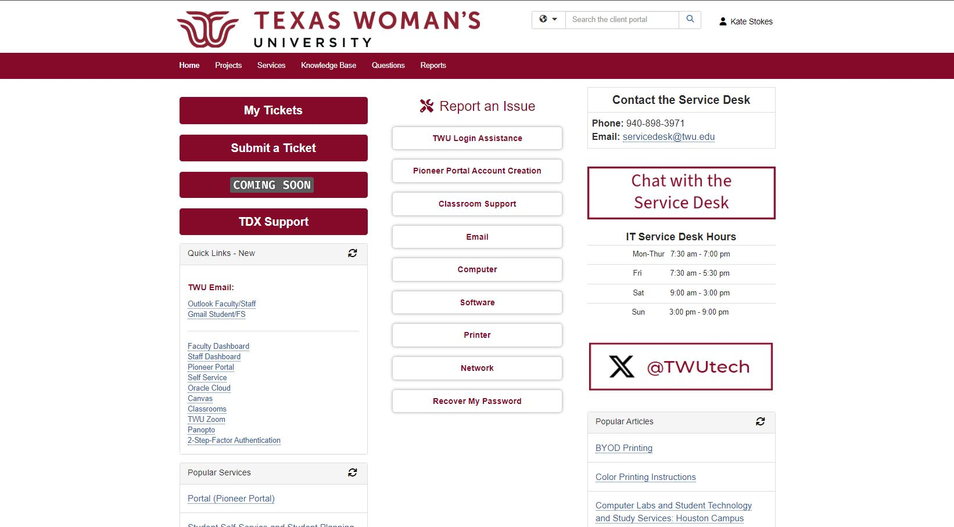
Locating our Ticketing System
Go to Service Center Portal: https://servicecenter.twu.edu/

Slide 4
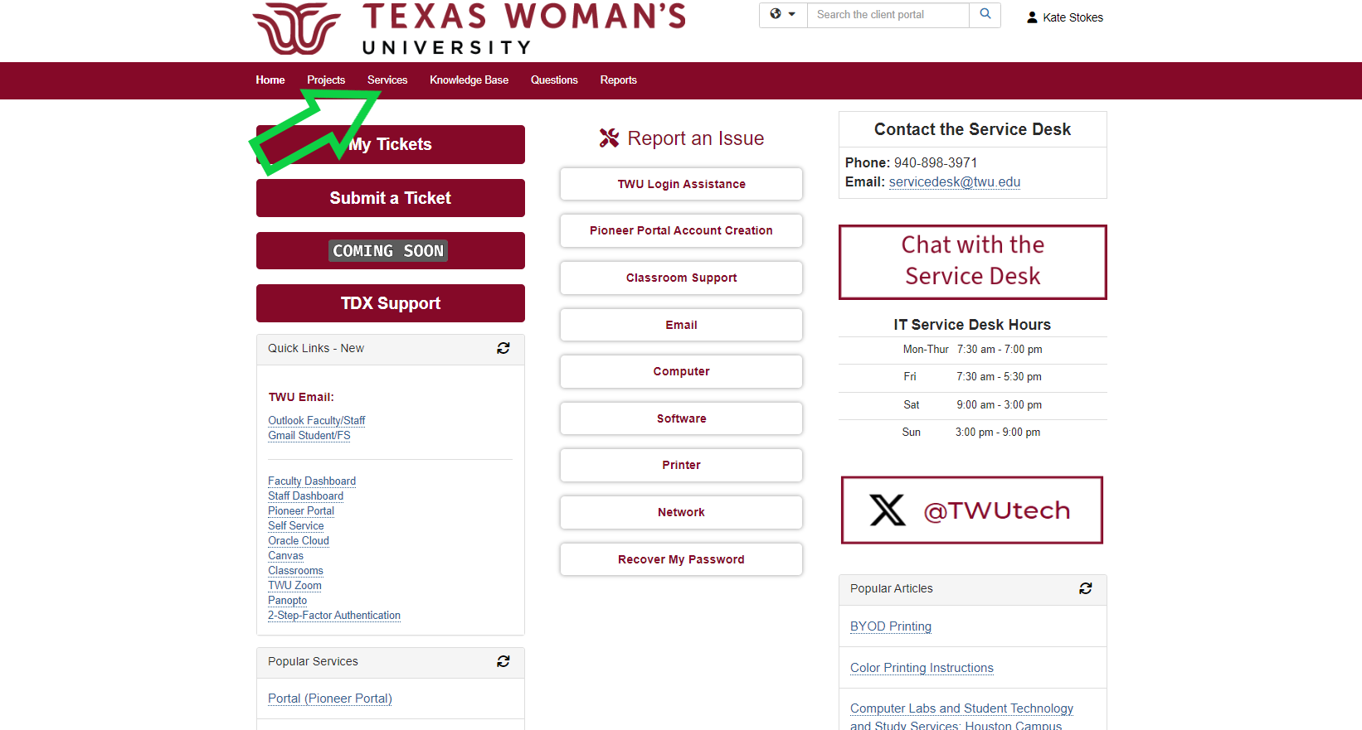
Locating our Ticketing System
Click on services

Slide 5
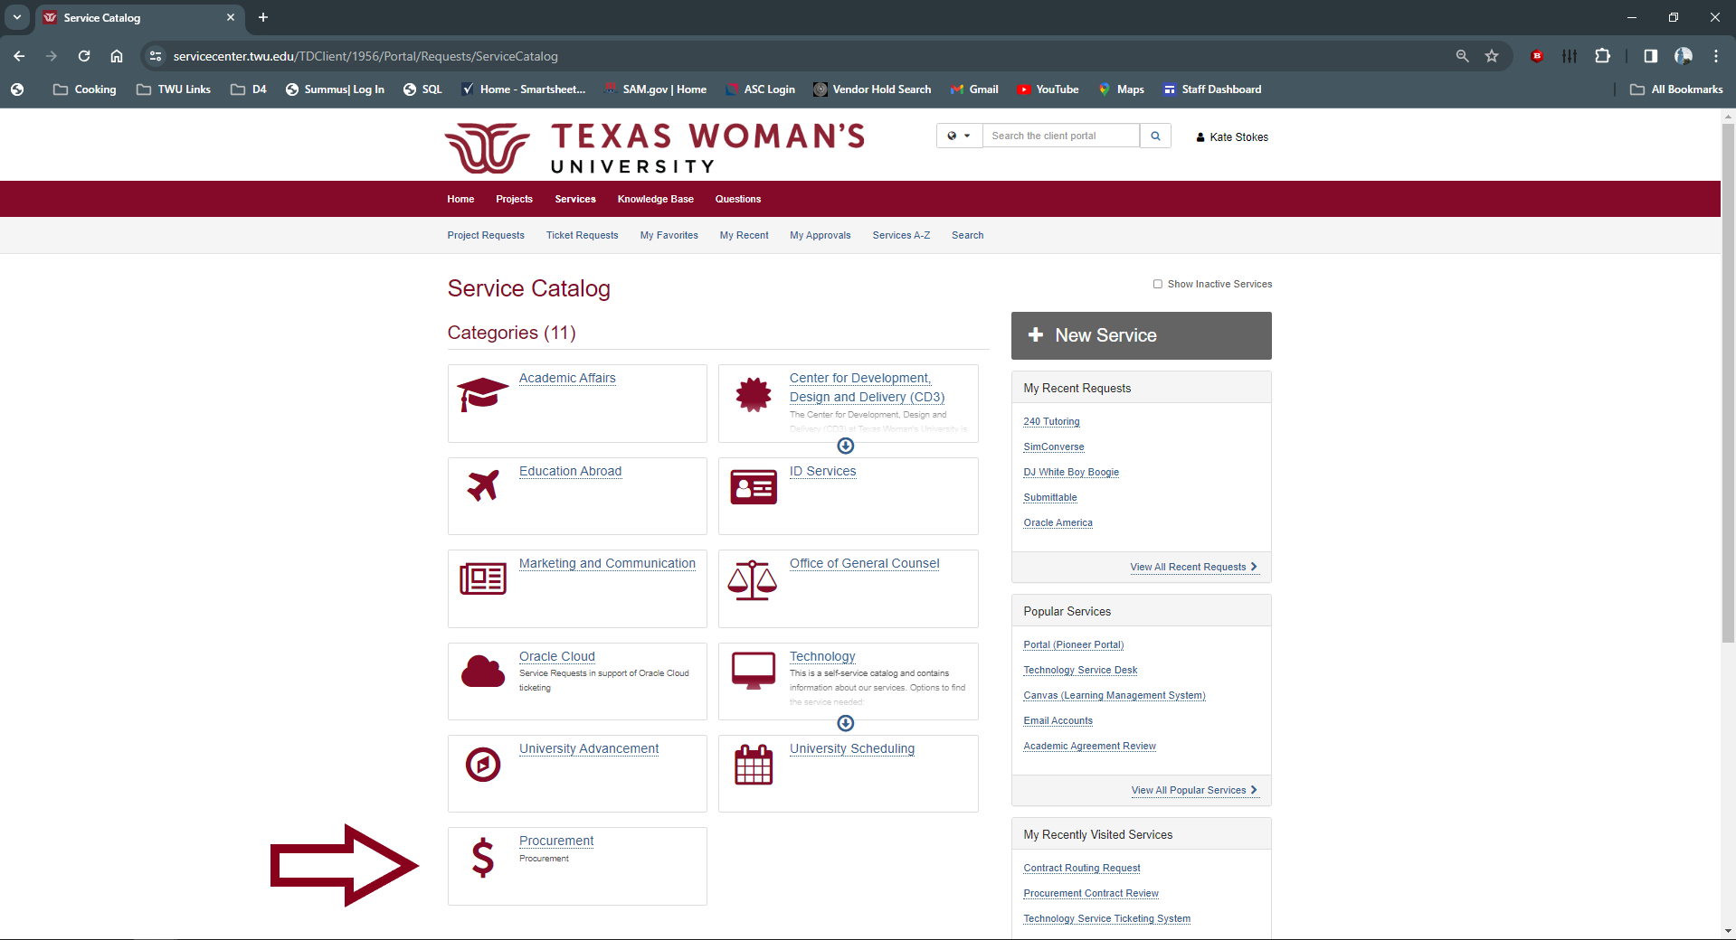
Locating our Ticketing System
Click on Procurement

Slide 6
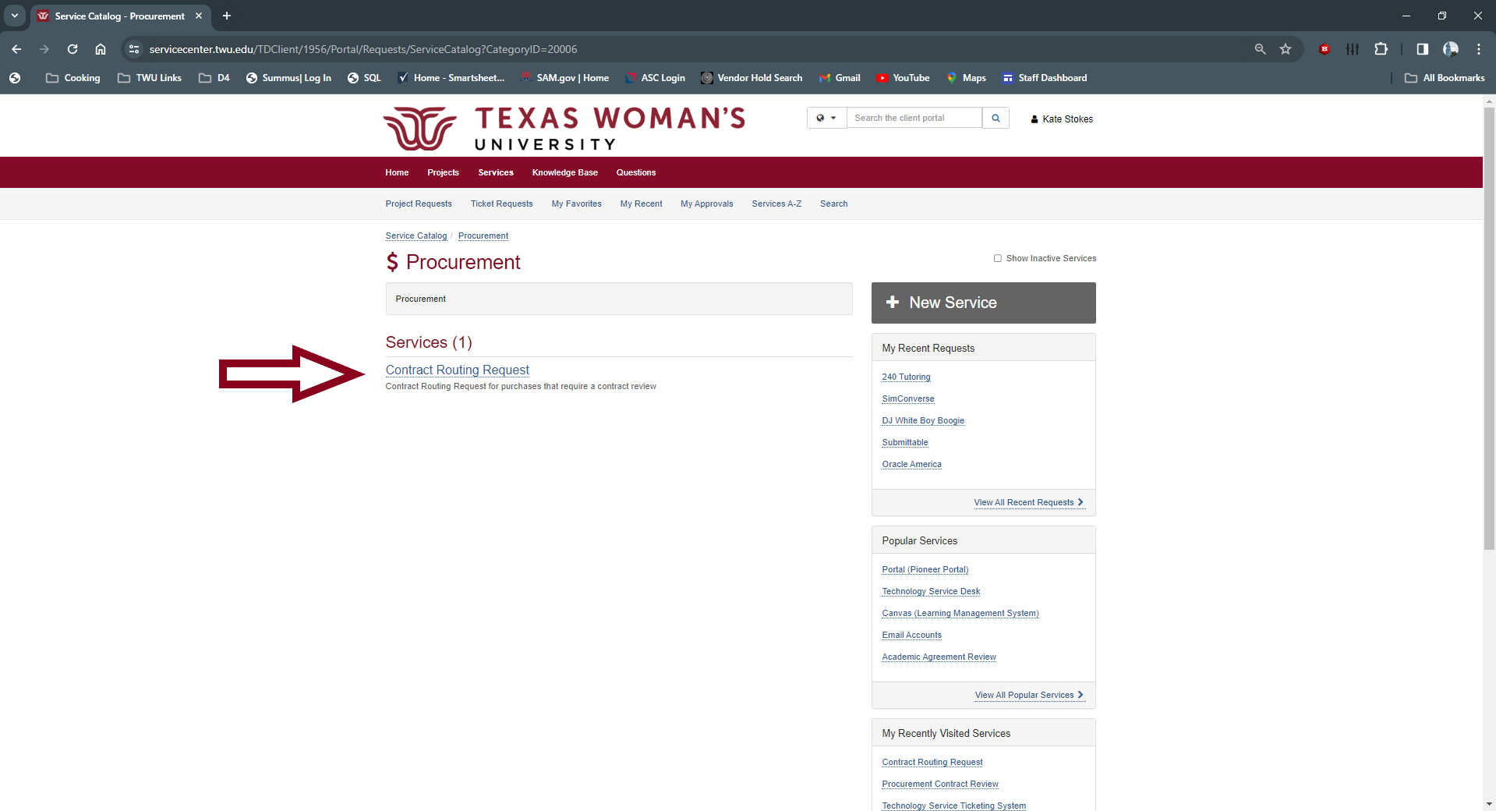
Locating our Ticketing System
Click on Contract Routing Request

Slide 7
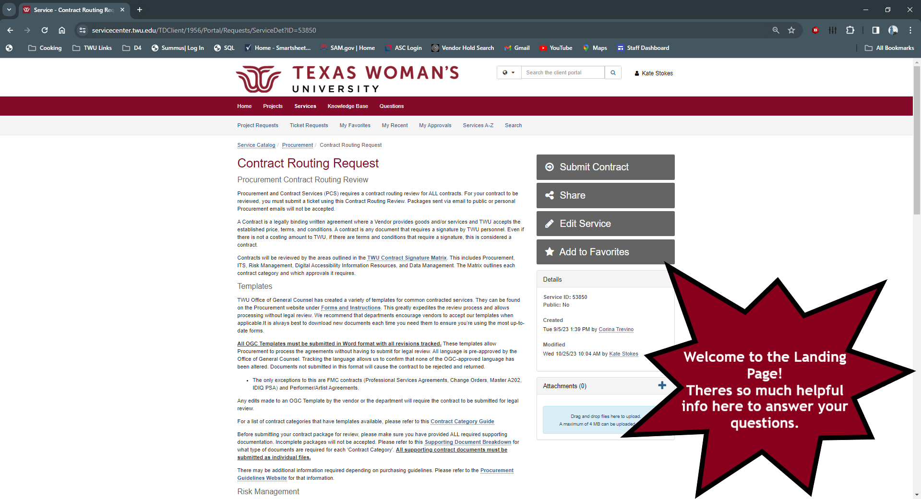
Welcome to the Landing Page!
There is a lot of helpful information here that will answer many of your questions. Hyperlinks are in blue. They contain documents and links to other internal TWU Areas involved in the Contract Routing Process.

Slide 8
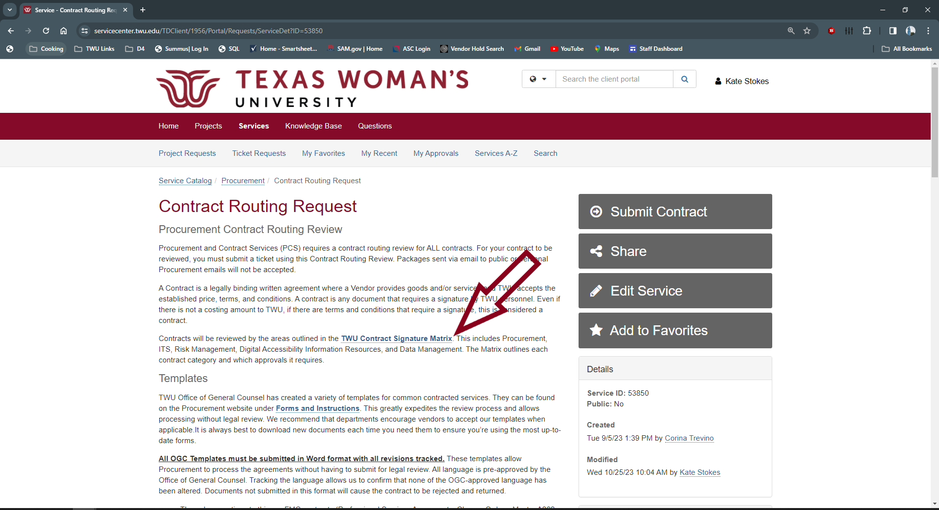
Signature Matrix
Each Fiscal Year, Chancellor Feyten signs off on the approvals required and signing authority for each type of contract. The only individuals with the authority to sign contracts on behalf of TWU are listed on the Signature Matrix. For Procurement Contracts, the only people with signing authority on behalf of TWU are the Chief Procurement Officer, VP of Finance and Administration and Chancellor.

Slide 9
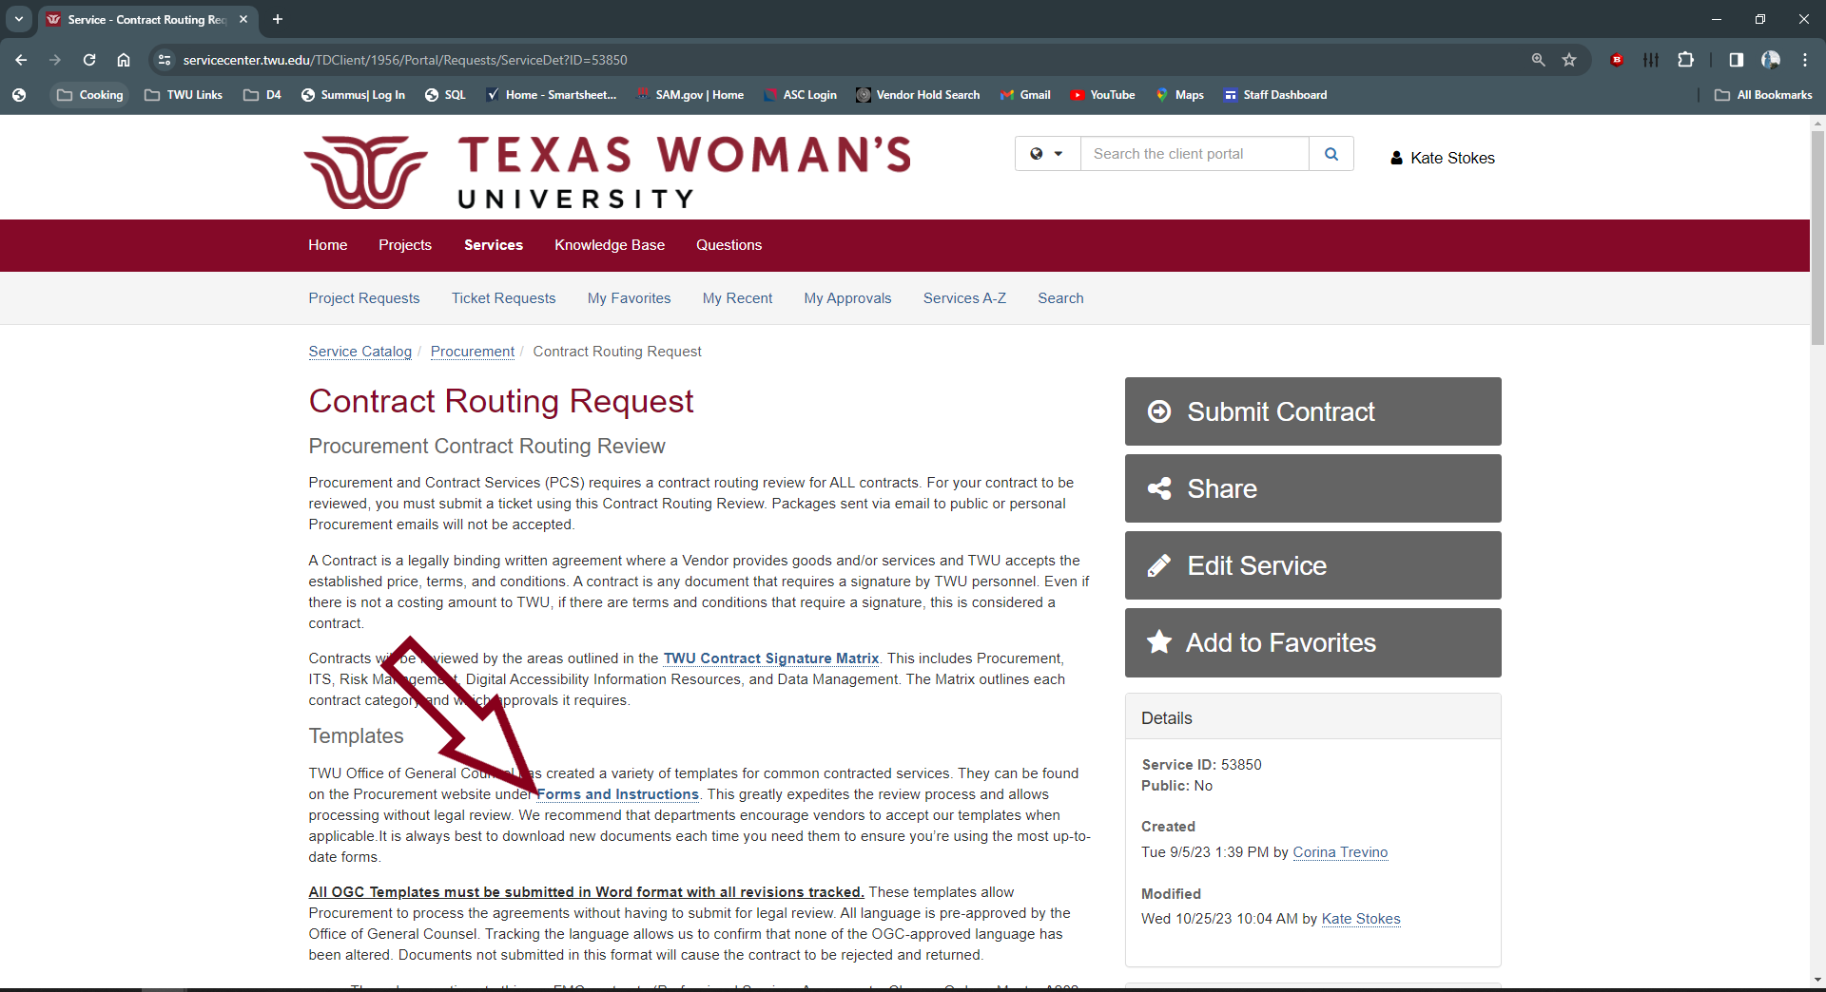
Forms and Instructions
All OGC Approved Contract Templates can be found on our Forms and Instructions Page. These templates greatly expedite the review process and allows us to forgo legal review of agreements.

Slide 10
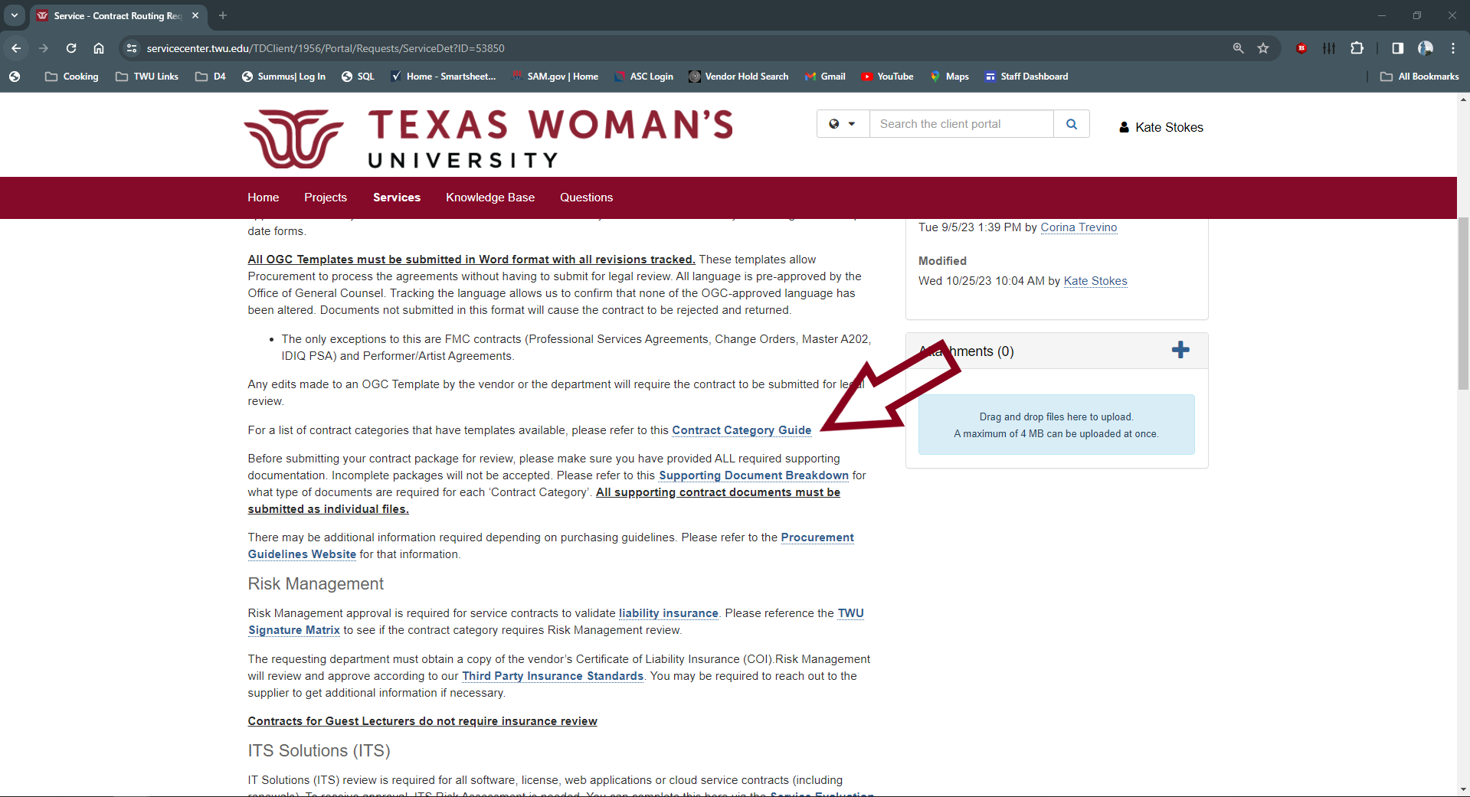
Contract Category Guide
Not sure what kind of contract you need or if there is a template? Check the Contract Category Guide!

Slide 11
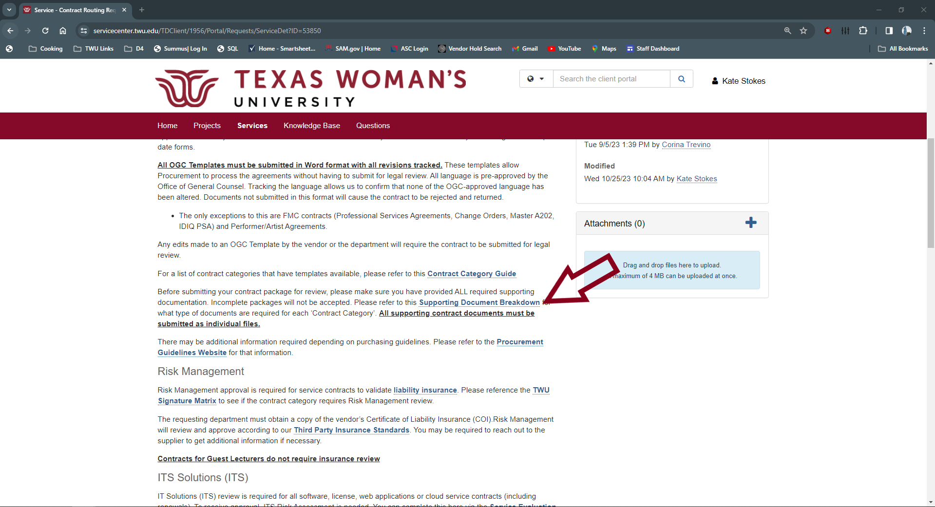
Supporting Documentation Breakdown
Not sure what you need to include in your package? Check the Supporting Documentation Breakdown!

Slide 12
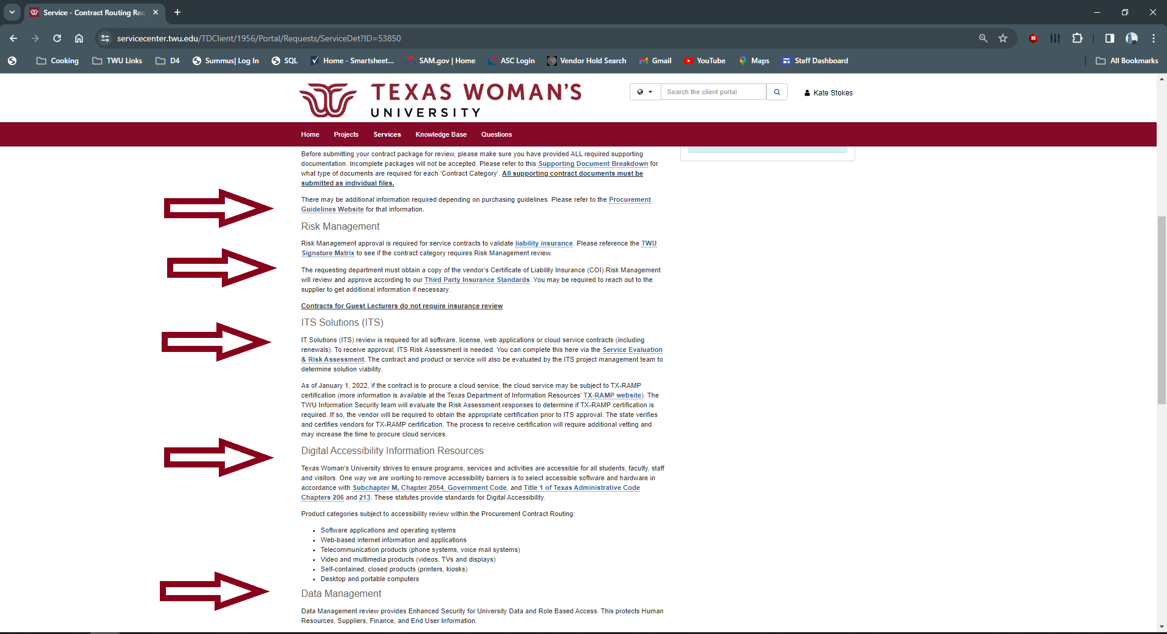
Standards for Procurement, Risk Management, ITS, Data Accessibility, and Data Management
Guidelines for our Texas Woman’s University Standards can be found on each area’s website. Please review these and make sure you’re working with Suppliers who meet our Standards.

Slide 13
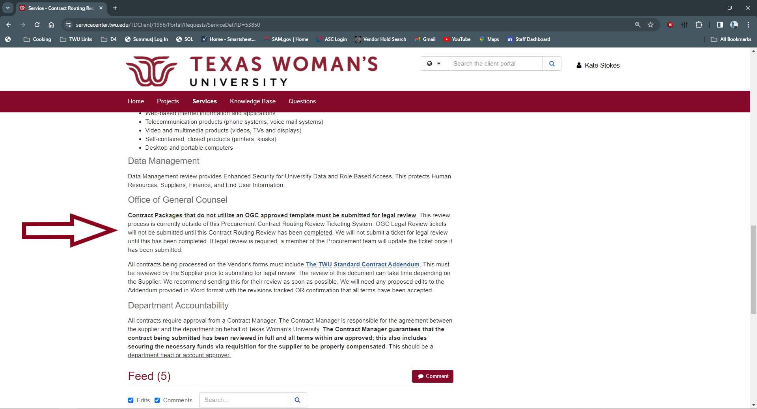
Legal Review
If you are not using an OGC Approved Template or a Supplier that is a Cooperative Purchasing Partner, the contract must be submitted to our Office of General Counsel for legal review. The legal review time frame is determined by a number of factors - number/length of documents for review, complexity of terms, volume of requests in OGC's line, and vendor edits and responsiveness. Please plan accordingly.

Slide 14
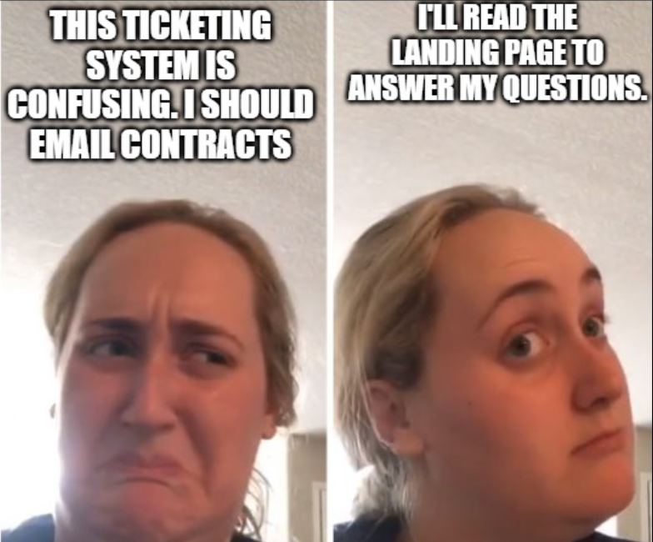
Have a lot of questions?
Take a moment and review the landing page!

Slide 15
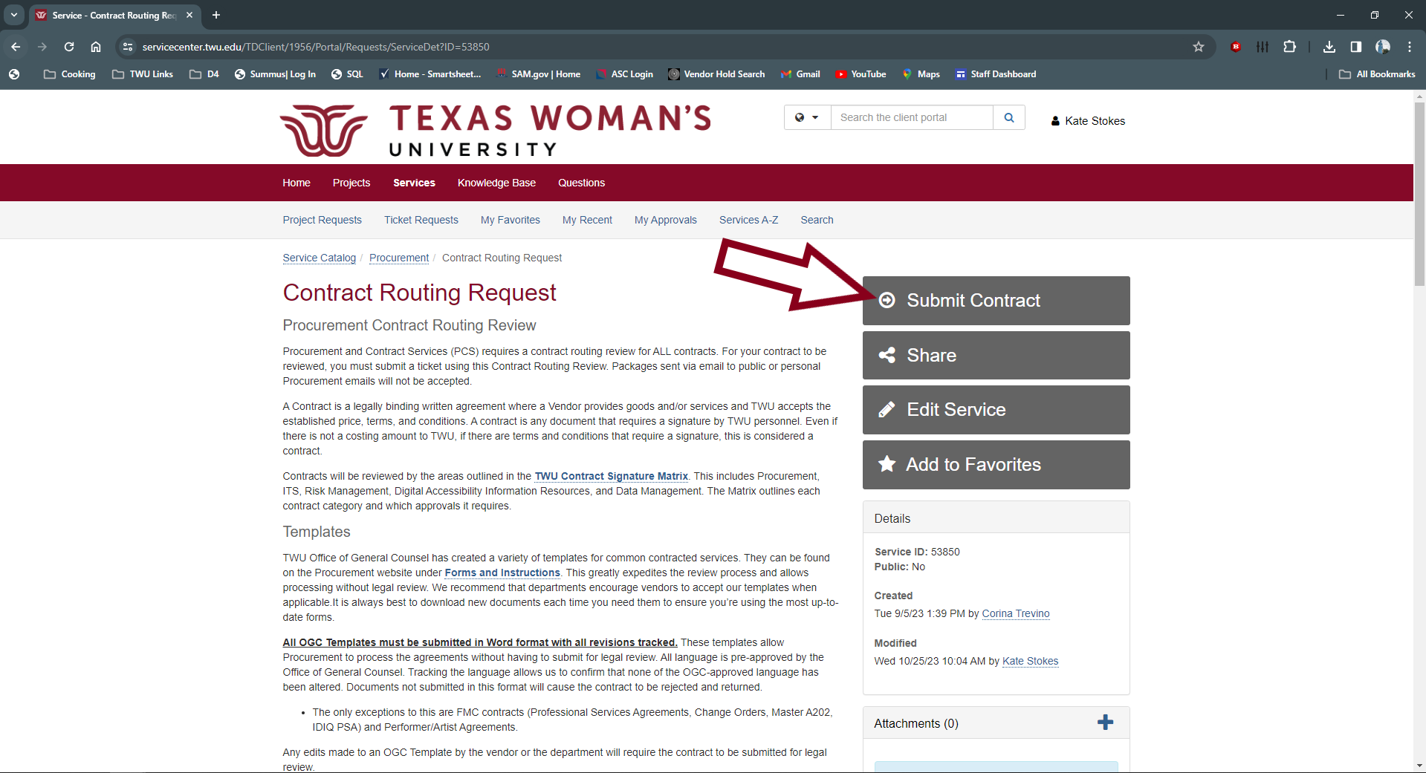
Creating a Contract Routing Ticket
Click on Submit Contract

Slide 16
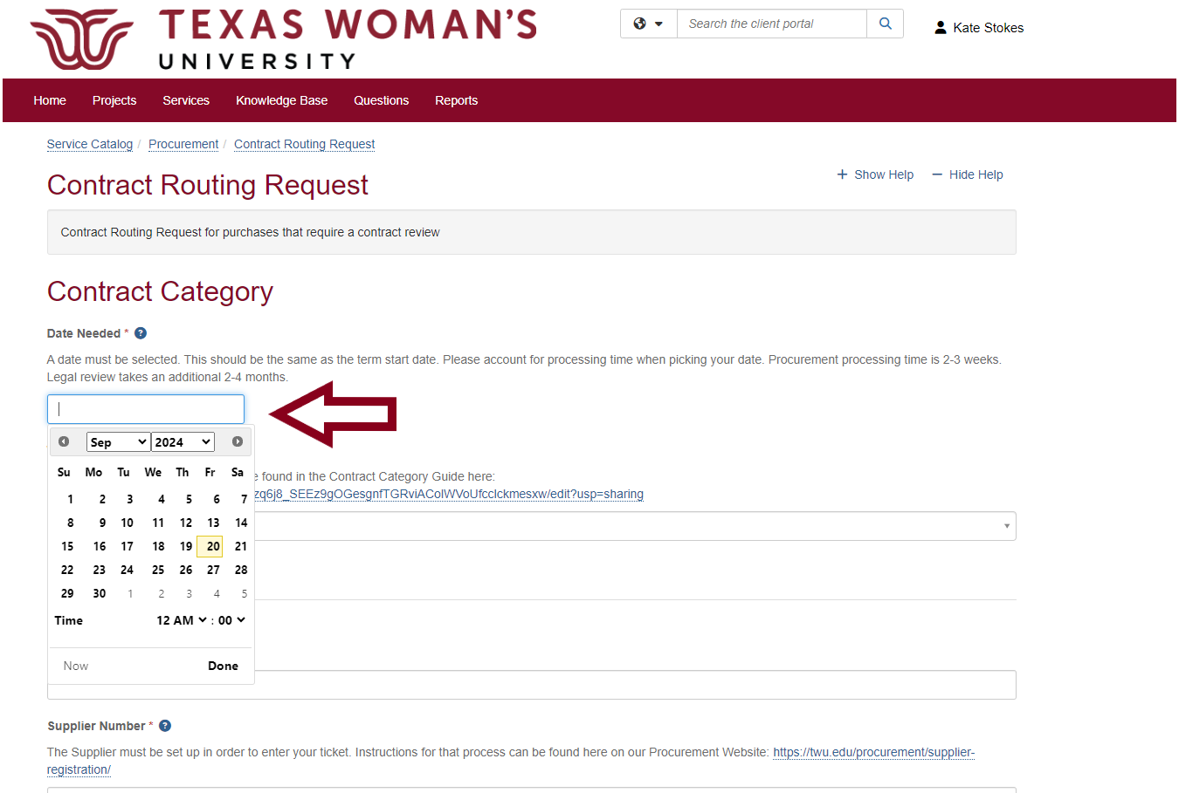
Need by date
Provide the date that you need the contract by. This should correspond with the start date of the agreement. If there isn’t a specific start date, please provide one. Please take into account processing time.

Slide 17
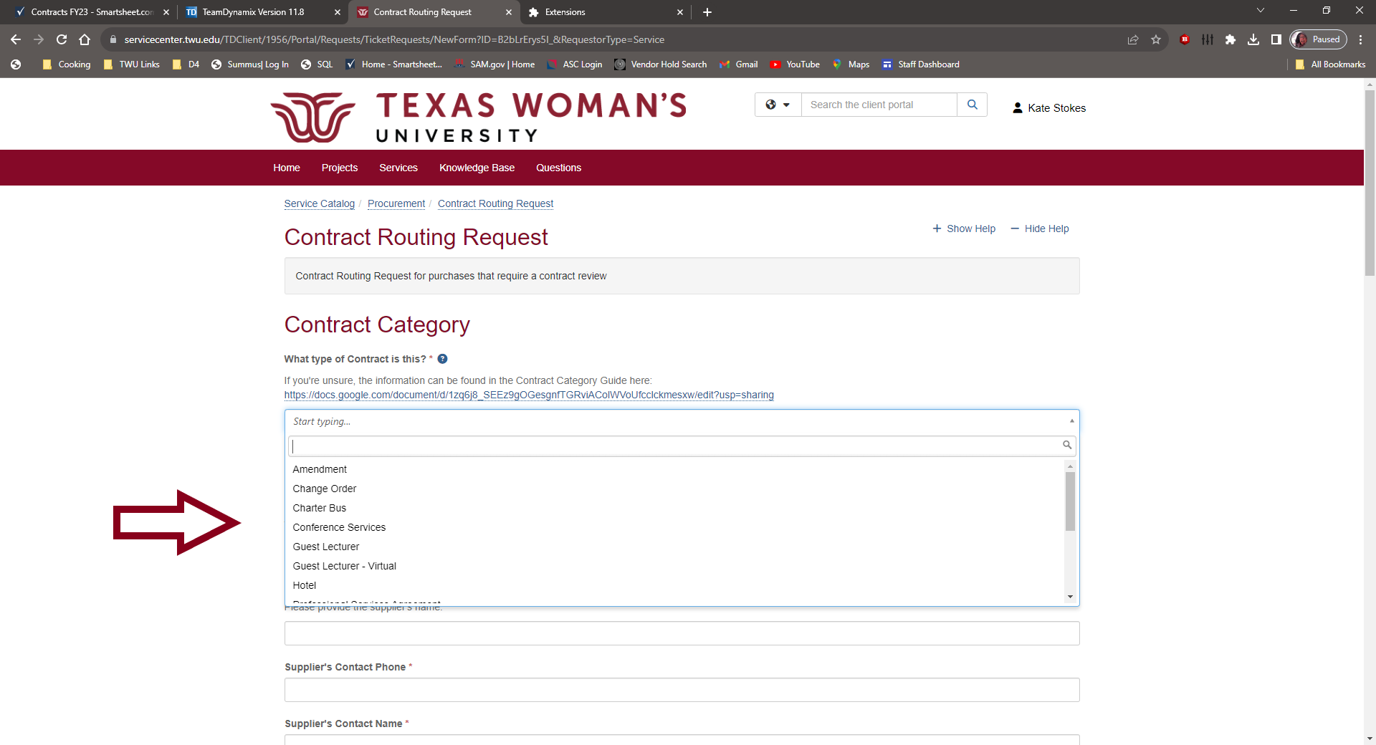
Choose your Contract Category
If you’re unsure of what type of contract you need, check out the link to the Contract Category Guide on the landing page. It will tell you which Category we have OGC created templates for. Quite helpful for trying to forgo legal review of contracts.

Slide 18
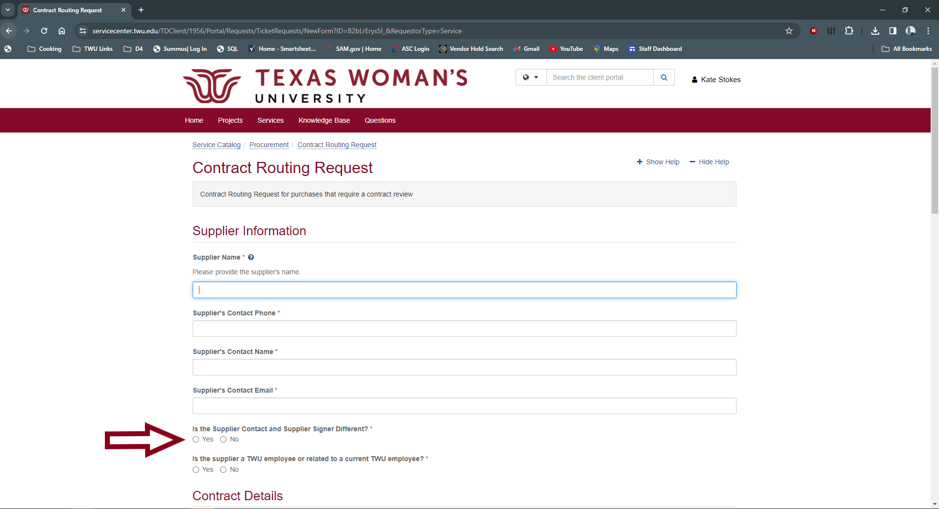
Fill out Supplier information
The Supplier must be set up in order to enter your ticket. Instructions for that process can be found here on our Procurement Website: https://twu.edu/procurement/supplier-registration/

Slide 19
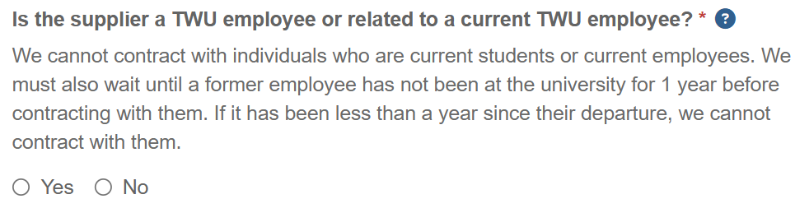
Supplier Relations
Notes:
We have added some clarification language to this question within our system. We are unable to contract with
current students, current employees, or ex employees who have been away from the university for less than a year.
There have been some questions regarding this, so we’ve added this to our help text.

Slide 20
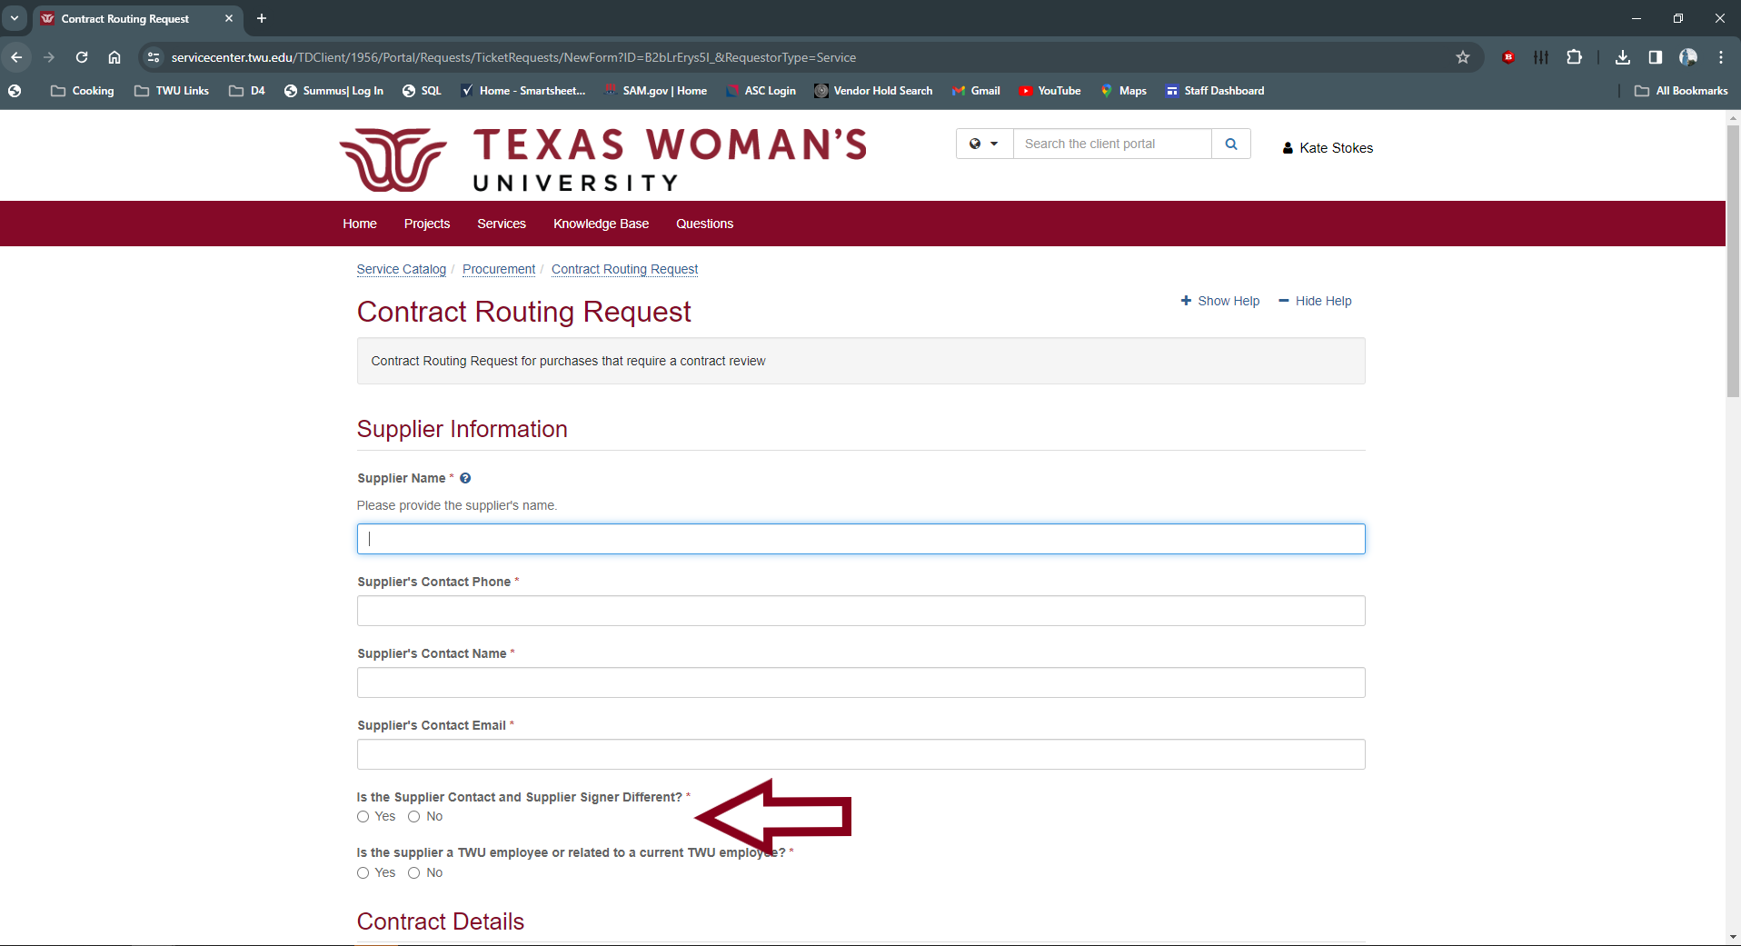
Supplier Contact & Supplier Signer
Sometimes the person with Signing authority on behalf of the Supplier is different than the Contact. Please check with your Supplier to confirm the Signer before submitting your contract.

Slide 21
Contact = Signer
If the Supplier Signer is the same as the contact, click NO

Slide 22
Contact ≠ Signer
If Supplier Signer is different than Contact, click YES

Slide 23
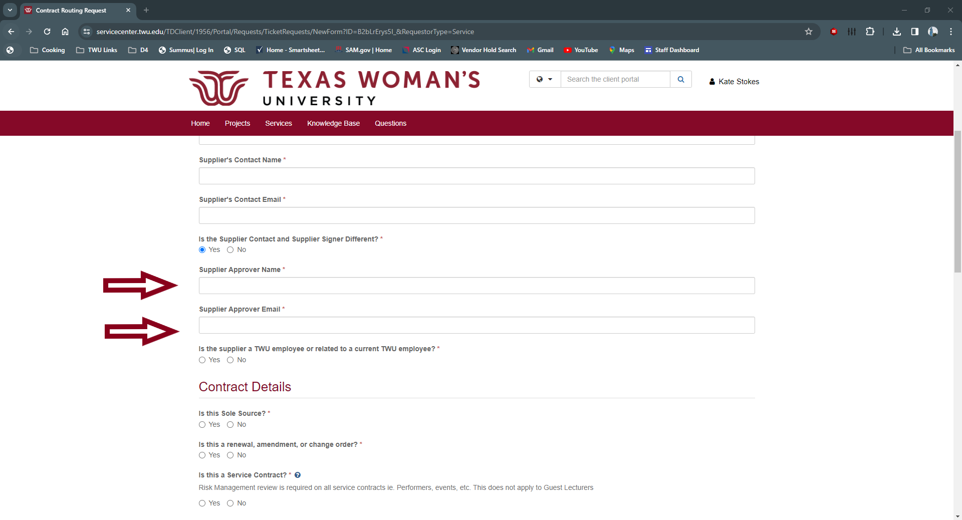
Signer Information
Add BOTH Name and Email for person signing on Supplier side. We will need this information for routing the contract for signature.

Slide 24
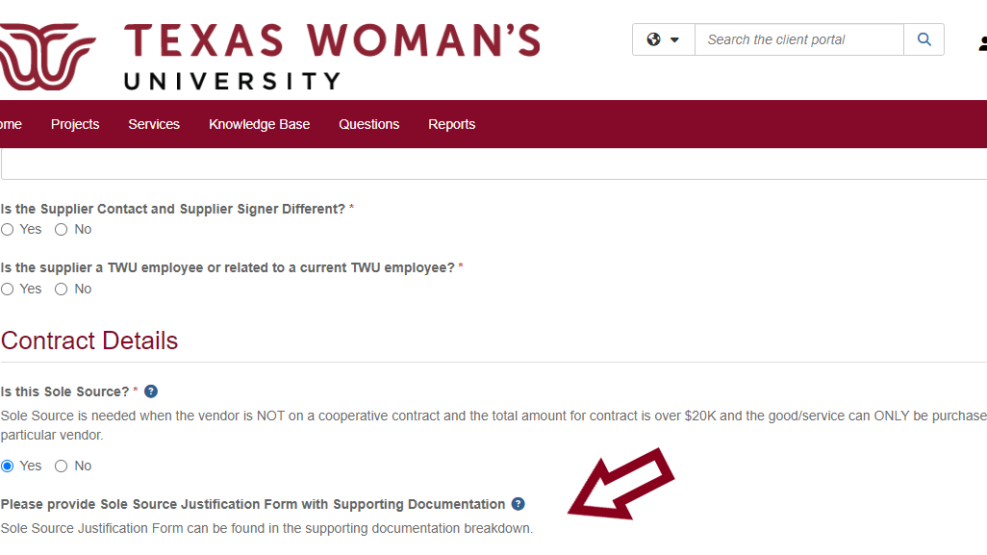
Is this a Sole Source?
Sole Source is needed when the supplier is NOT on a cooperative contract and the total amount for contract is over $50K and the good/service can ONLY be purchased from that particular supplier.
Notes:
New

Slide 25
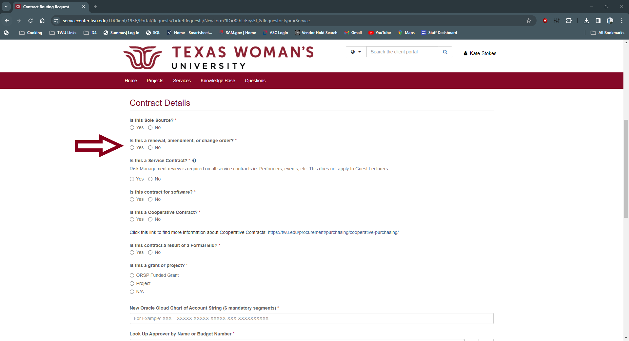
Is this a Renewal, Change Order, or Amendment?
Click yes if any of these apply.

Slide 26
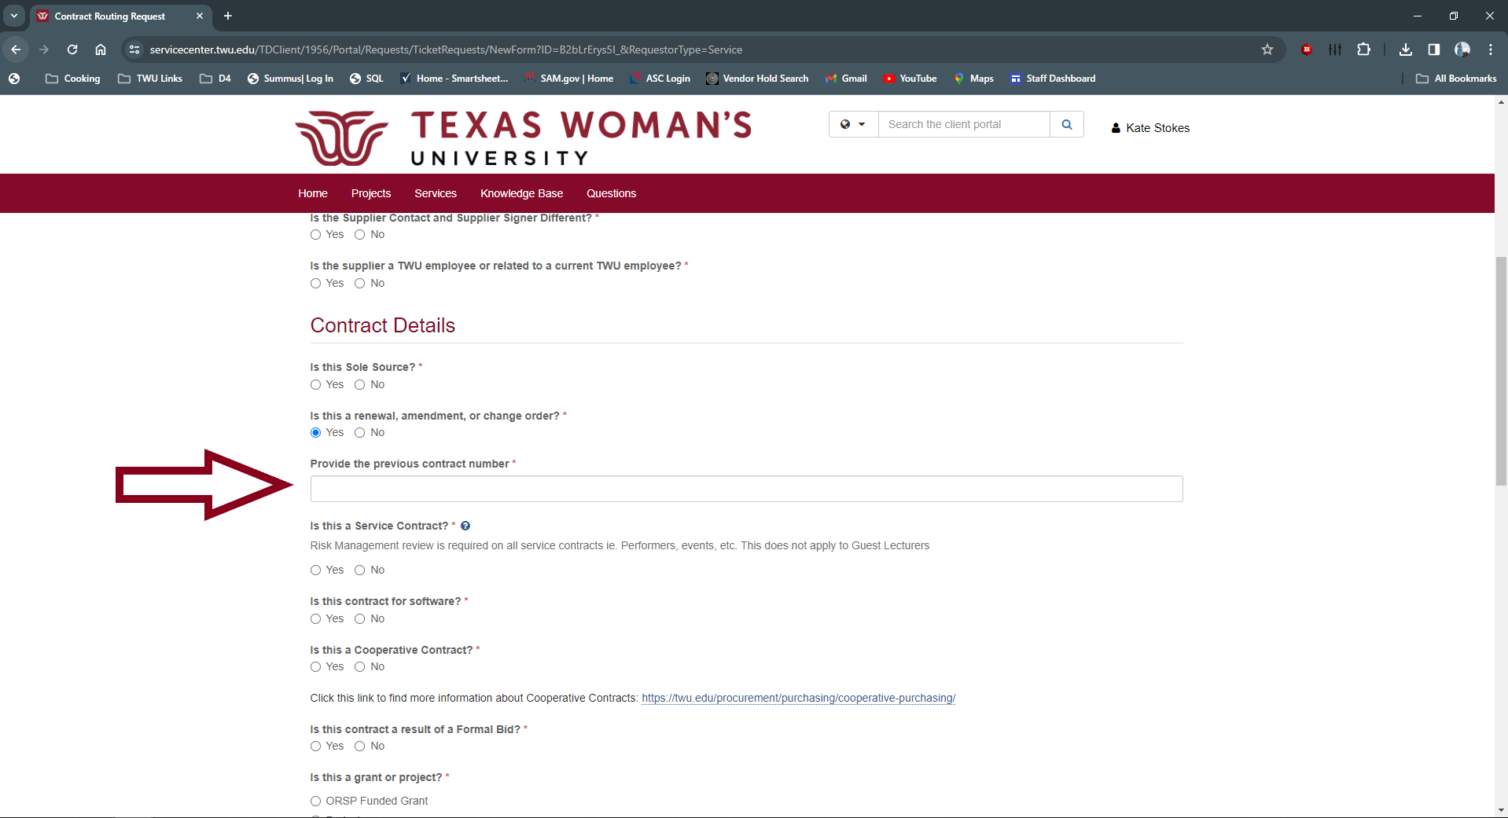
Previous or Related Contract Number
If Yes, please provide us with the Previous Contract Number attached to this renewal agreement (ASC-XXXX-XXX, PSC-XXXX-XXX, etc.)

Slide 27
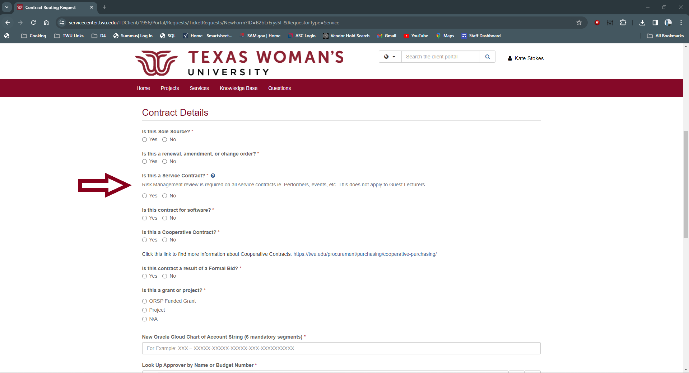
Is this a Service?
Risk Management review is required on all service contracts. The only exception is Guest Lecturers, Advertising Agreements, and Athletic Team Hotels. All other agreements are considered services and must be viewed by Risk Management. If you are unsure if Risk Management needs to review your agreement, please review the TWU Signature Matrix here: https://twu.edu/media/documents/procurement/FY24-Contract-Signature-Matrix-signed.pdf

Slide 28
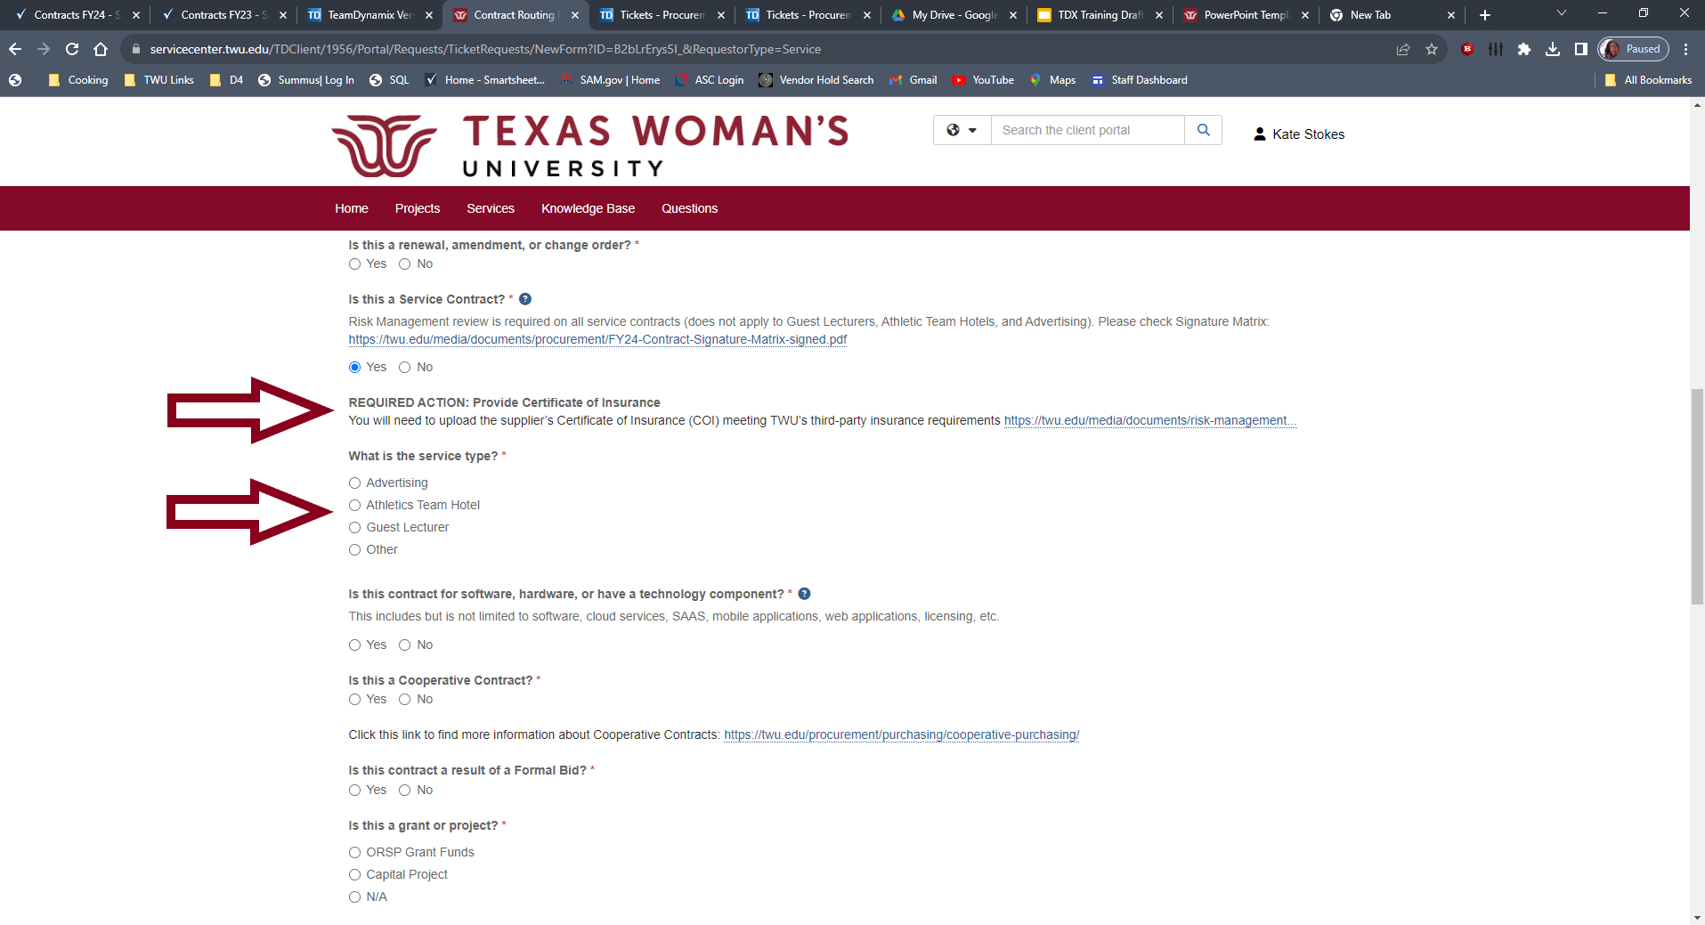
Certificate of Insurance (COI)
You will need to upload the supplier’s Certificate of Insurance (COI) meeting TWU’s third-party insurance requirements https://twu.edu/media/documents/risk-management/TWU-Third-Party-Insurance-Standards.pdf
**If you are seeking a waiver on the Certificate of Insurance Requirement - Please add that information in the description box later in the form**

Slide 29
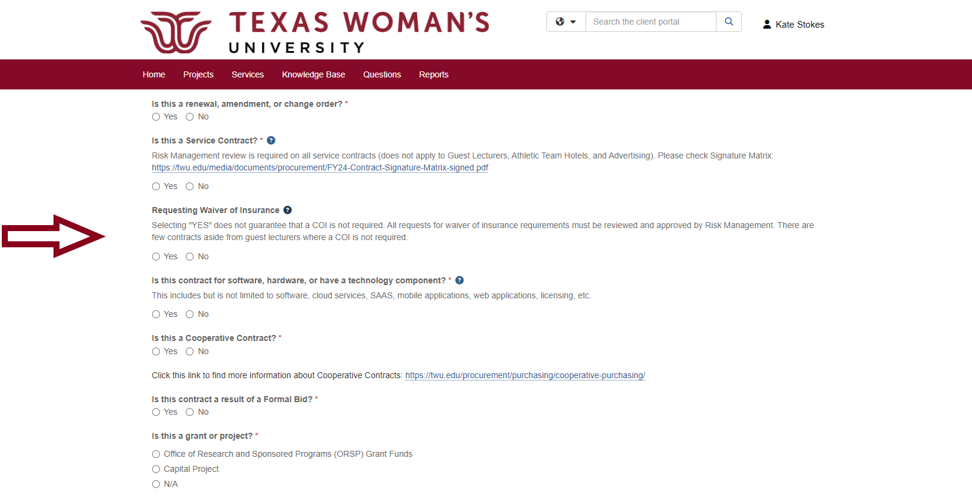
Need a waiver?
We’ve added a toggle if you’re requesting a waiver of insurance. Please note, very few agreements do not require a COI. You still may be requested to provide one from the supplier.

Slide 30
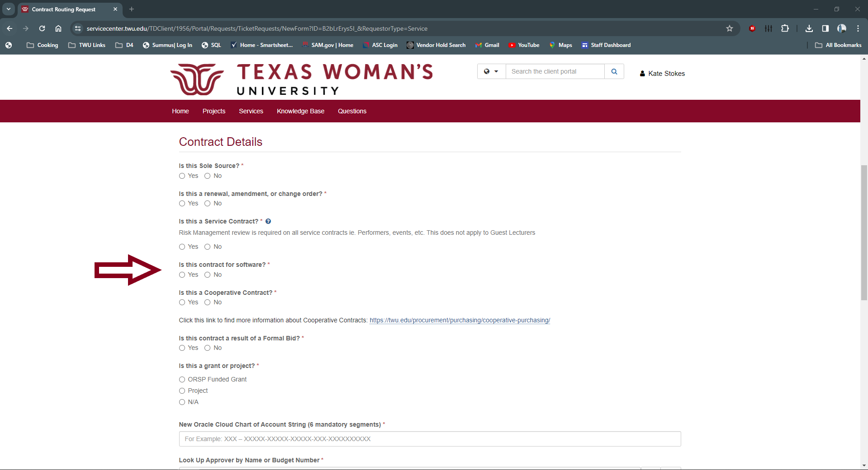
Software Contracts
Is this contract for software, hardware, or have a technology component? This includes, but is not limited to: software, cloud services, SAAS, mobile applications, web applications, licensing, etc.

Slide 31
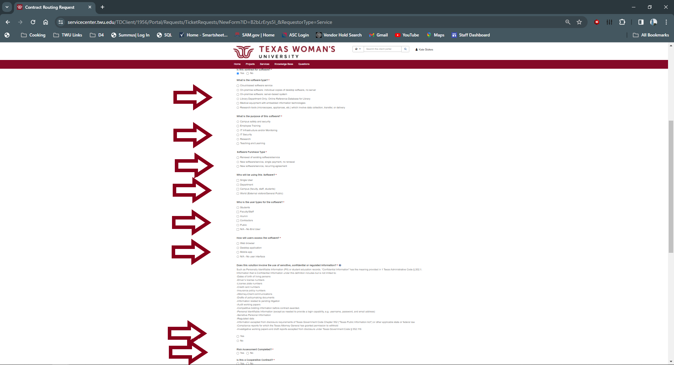
Software Contracts
If it is for Software, you will need to complete the expanded questions. Questions with checkboxes allow for multiple answers. If you are unsure, please read the agreement or ask the Supplier. Your Risk Assessment completed by IT Solutions should contain a lot of the same information.

Slide 32
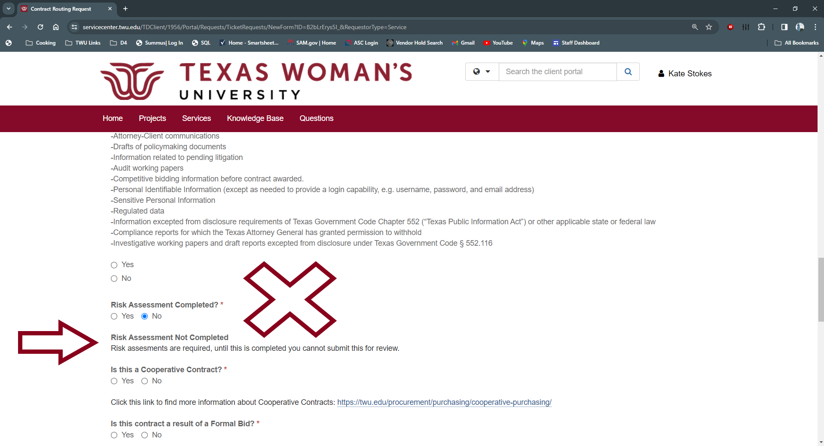
Risk Assessment
Risk Assessments need to be included with your Supporting Documentation. You must have a completed Risk Assessment by ITS to submit your Contract for review. Contracts submitted without completed Risk Assessments will be rejected. Link to ITS TDX for Risk Assessment: https://servicecenter.twu.edu/TDClient/1956/Portal/Requests/ServiceDet?ID=12086

Slide 33
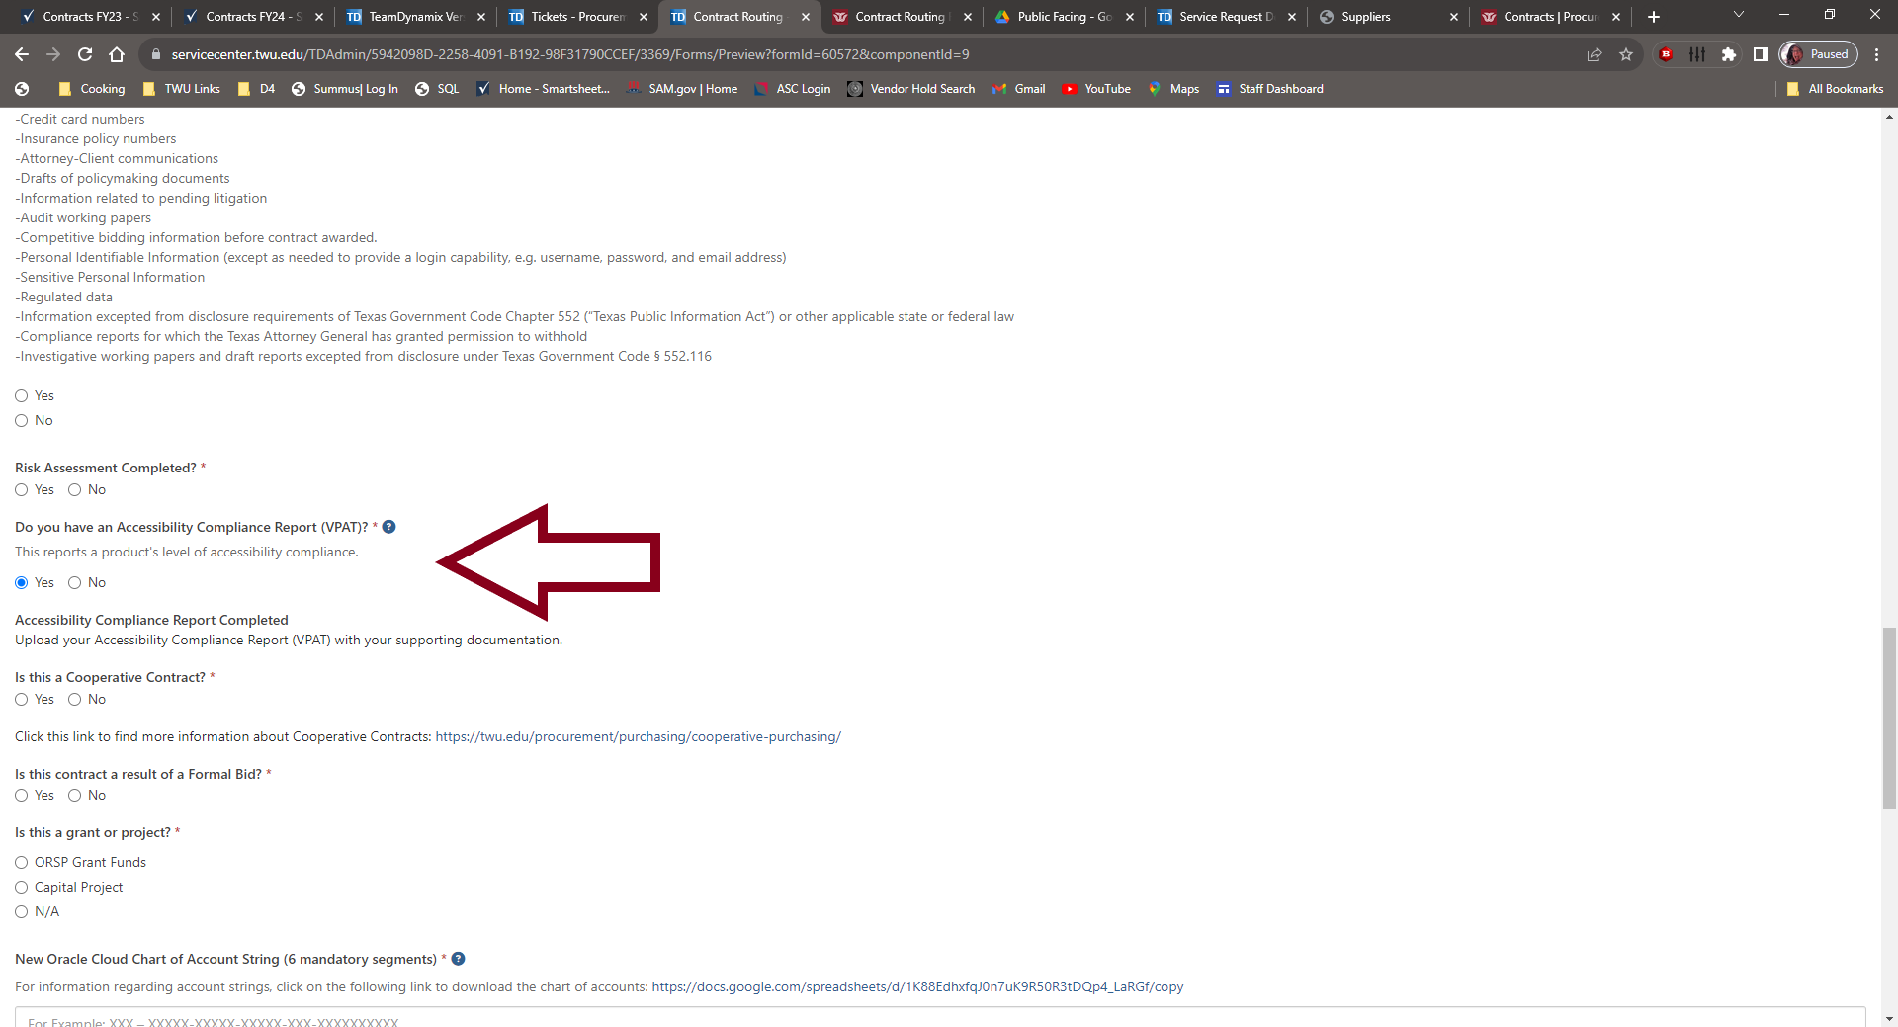
Accessibility Compliance Report (VPAT)
For all Software, you must include an Accessibility Compliance Report. This is provided by the Supplier.

Slide 34
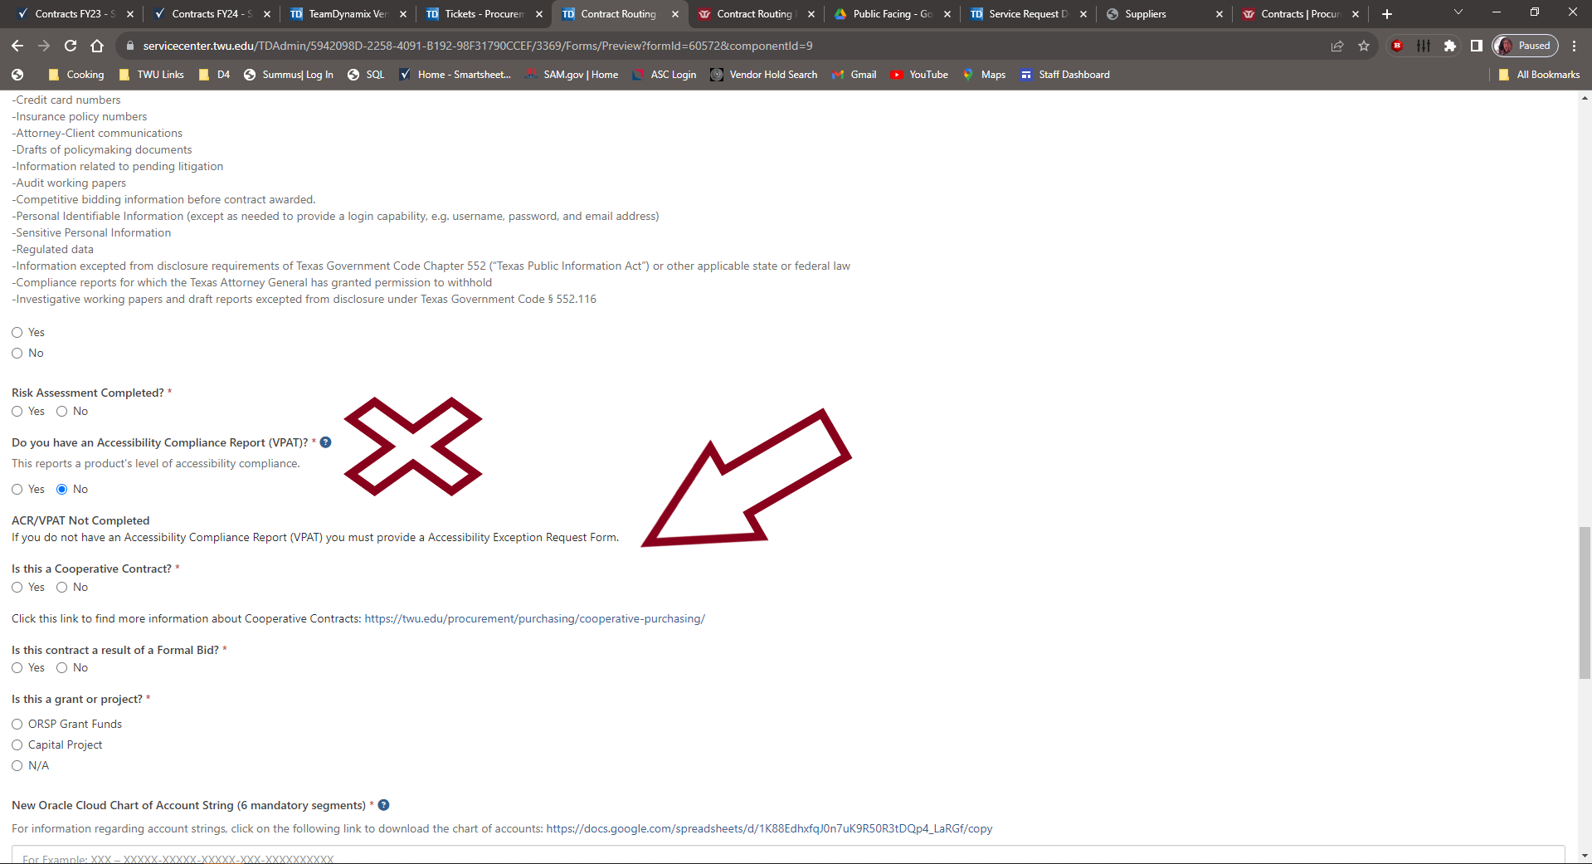
Accessibility Exception Request Form
If the Supplier does not have an Accessibility Compliance Report (VPAT), then you must provide a completed Accessibility Exception Request Form. Link to document download is located in Supporting Documentation Breakdown.

Slide 35
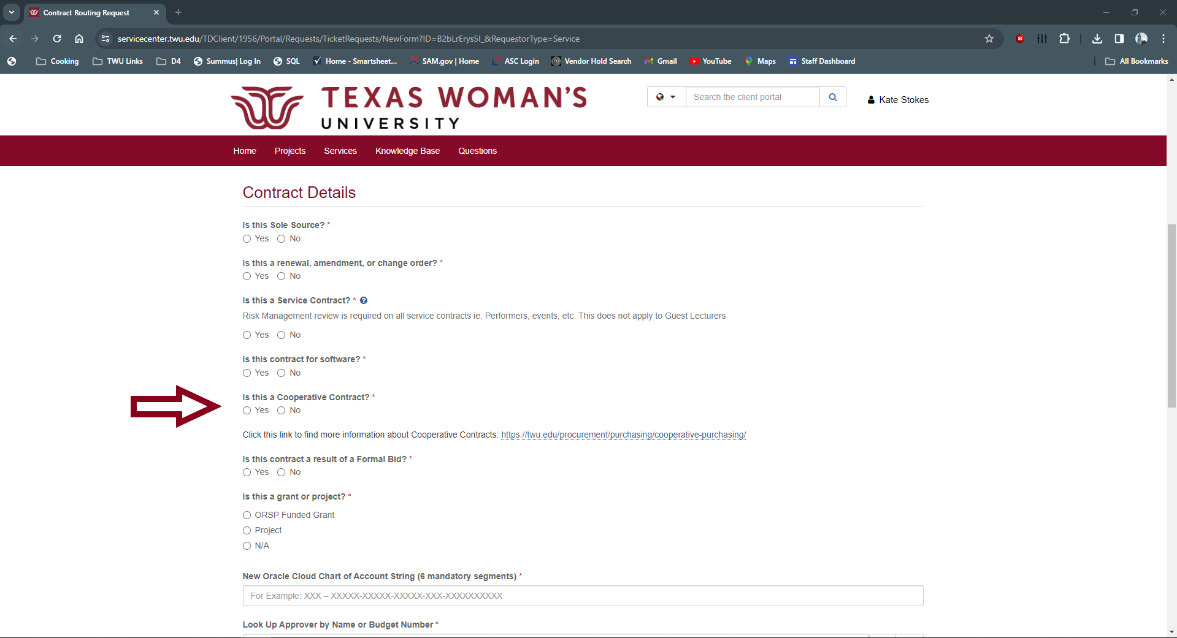
Is the Supplier on a Cooperative?
If you are submitting a contract with a Cooperative Purchasing Partner, we will need that information from you as well. Using suppliers available on Cooperatives, full fills the procurement method (No Bids or Sole Source to worry about) and if the vendor accepts our Standard Contract Addendum, we can process without sending for legal review.

Slide 36
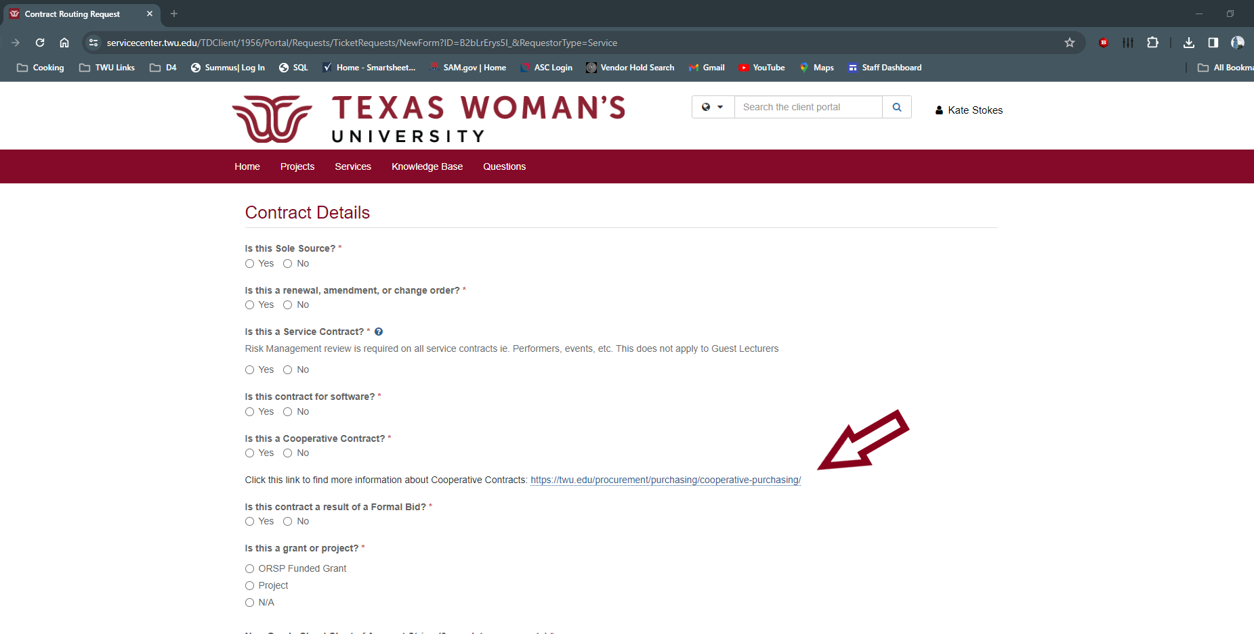
Cooperative Purchasing Partners
Not sure if the Supplier you’re wanting to contract with is on a Cooperative? Ask your Supplier! You can find more information on Cooperative Purchasing partners on our website: https://twu.edu/procurement/purchasing/cooperative-purchasing/

Slide 37
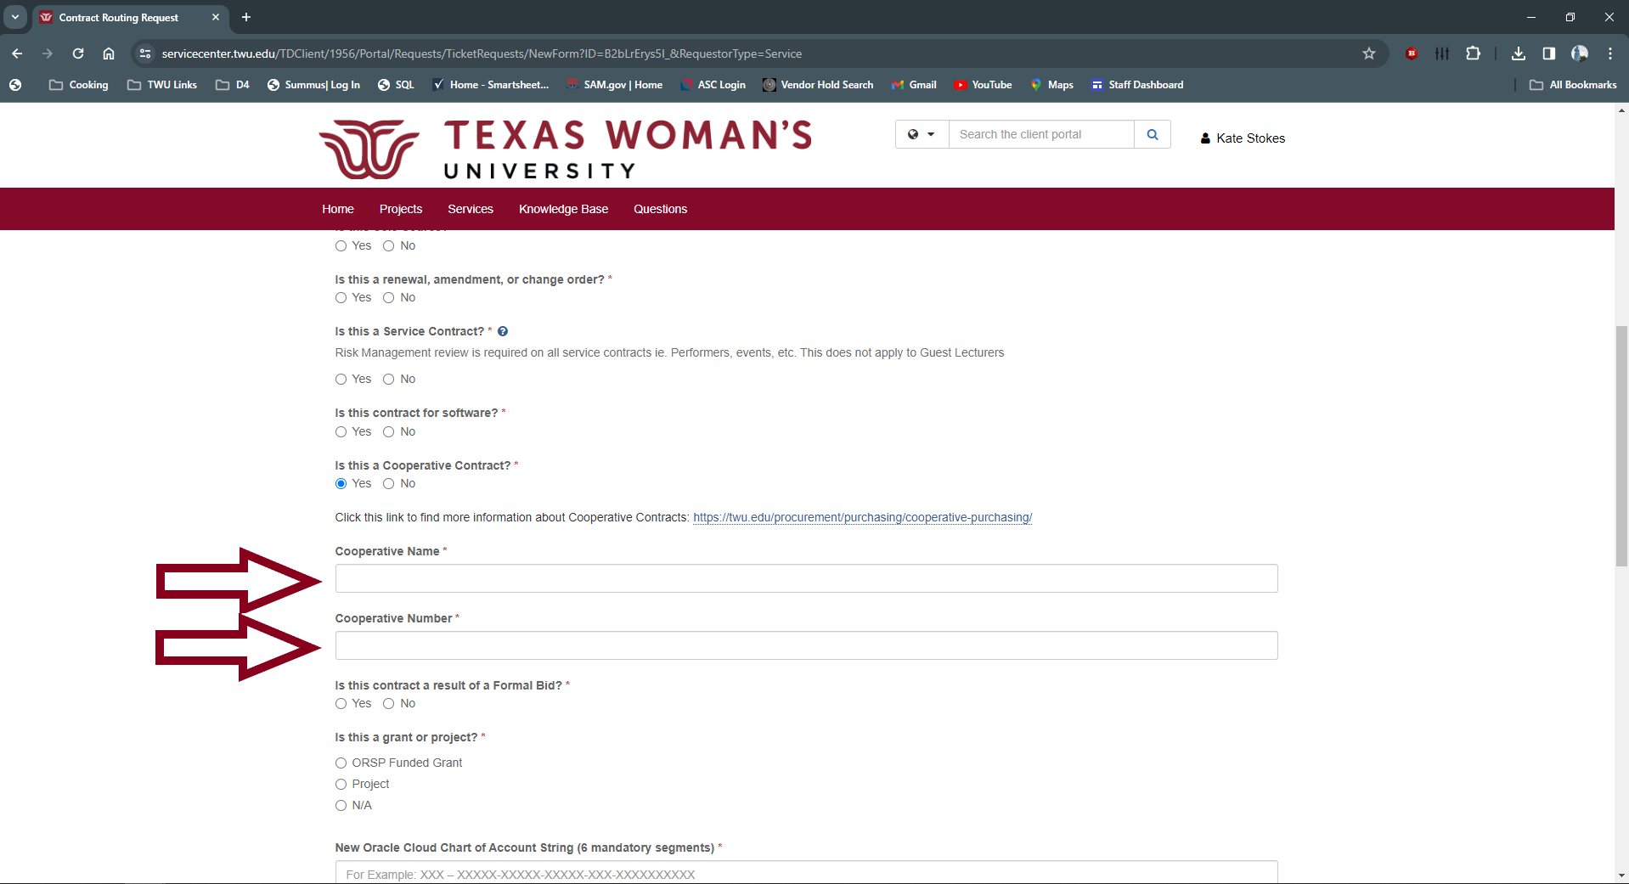
If Supplier is on a Cooperative
List the name of the Cooperative and the Cooperative Contract Number. This Cooperative Partner and Contract Number must also be referenced on the Contract Document. Please review and make sure its there. If not, reach out to your supplier and have them add it.

Slide 38
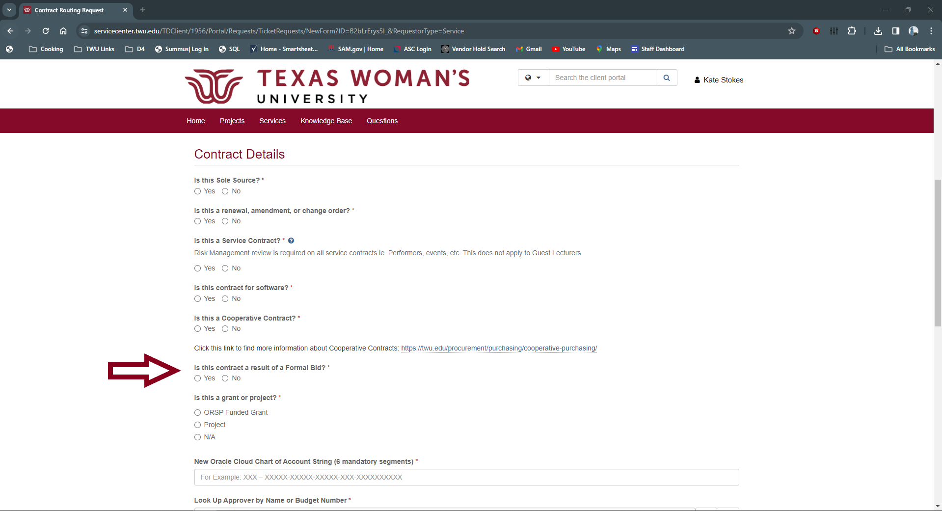
Is your contract part of a Formal Bid?
Formal Bids are required when the supplier is NOT on a cooperative contract and the total amount for contract is over $100K. Information regarding formal bids can be found on our Procurement Guidelines website here: https://twu.edu/procurement/purchasing/procurement-guidelines/

Slide 39
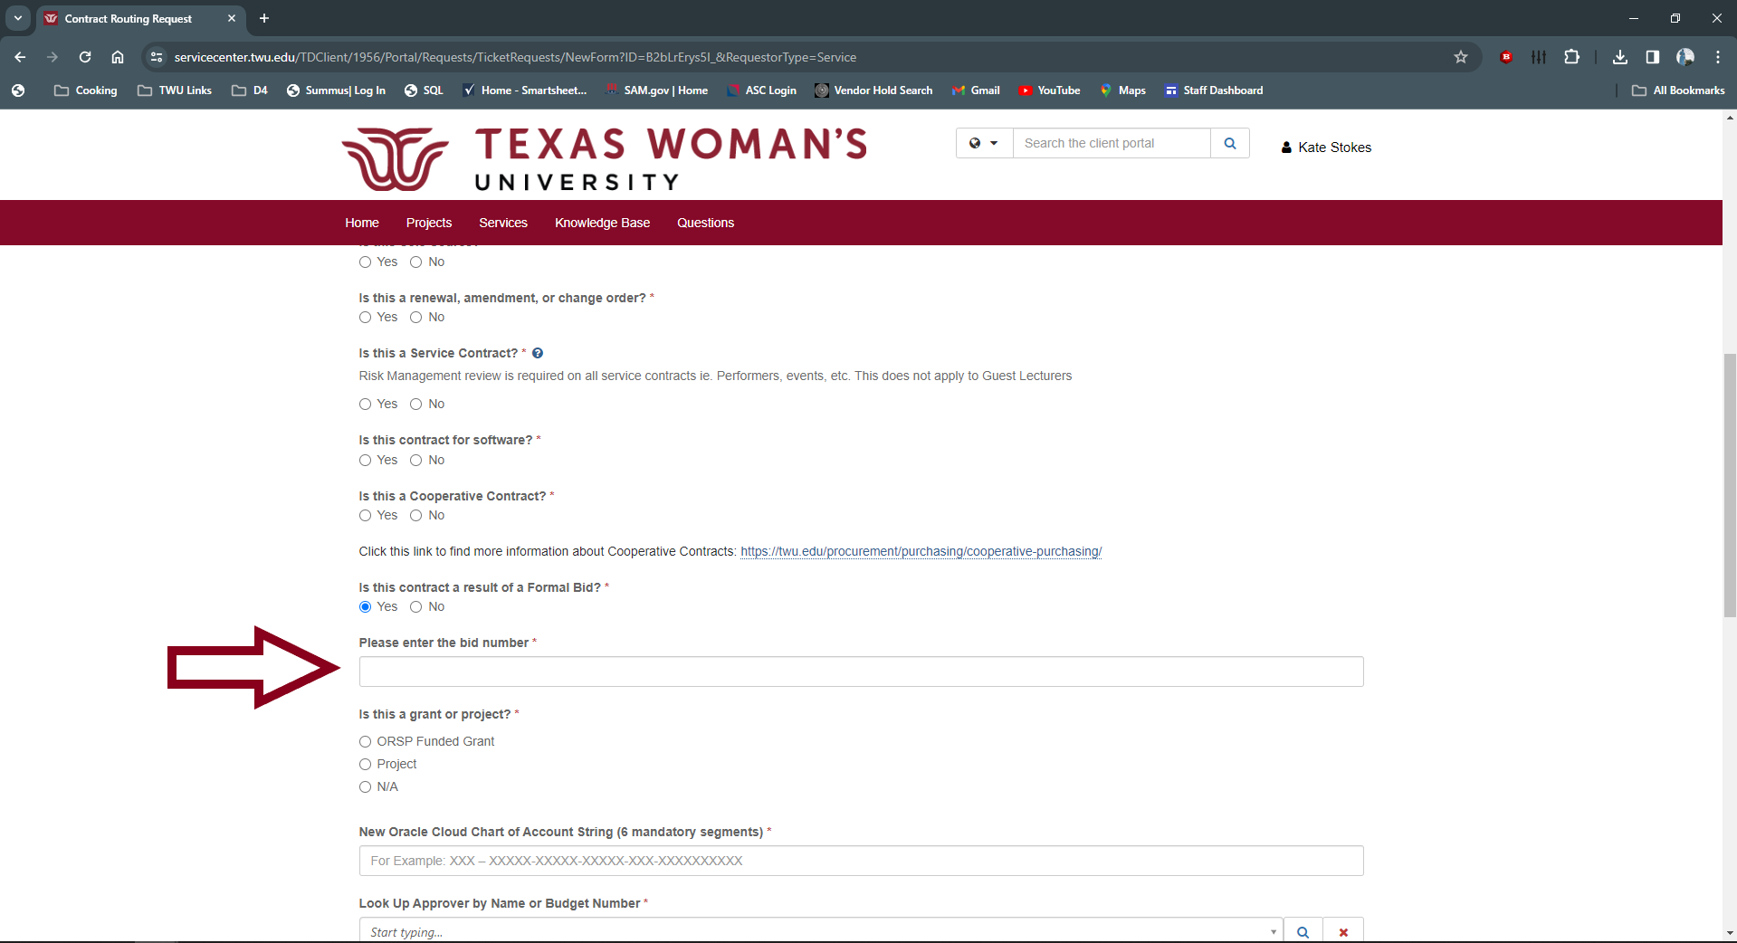
Formal Bid Number (RFP)
Enter the Formal Bid (RFP) number here. This number also needs to be referenced on the Contract Document. Please make sure it is on there. If not, reach out to the supplier and have them add it.

Slide 40
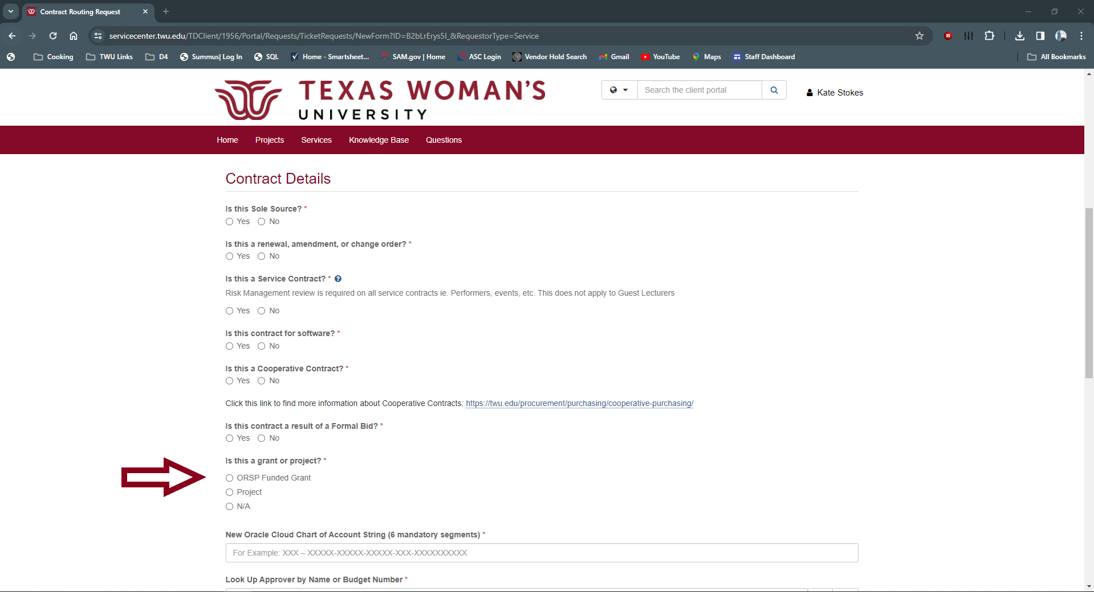
Grant or Capital Projects
If you are using funds from a Office of Research and Sponsored Programs Grant or Capital Project, please let us know here.

Slide 41
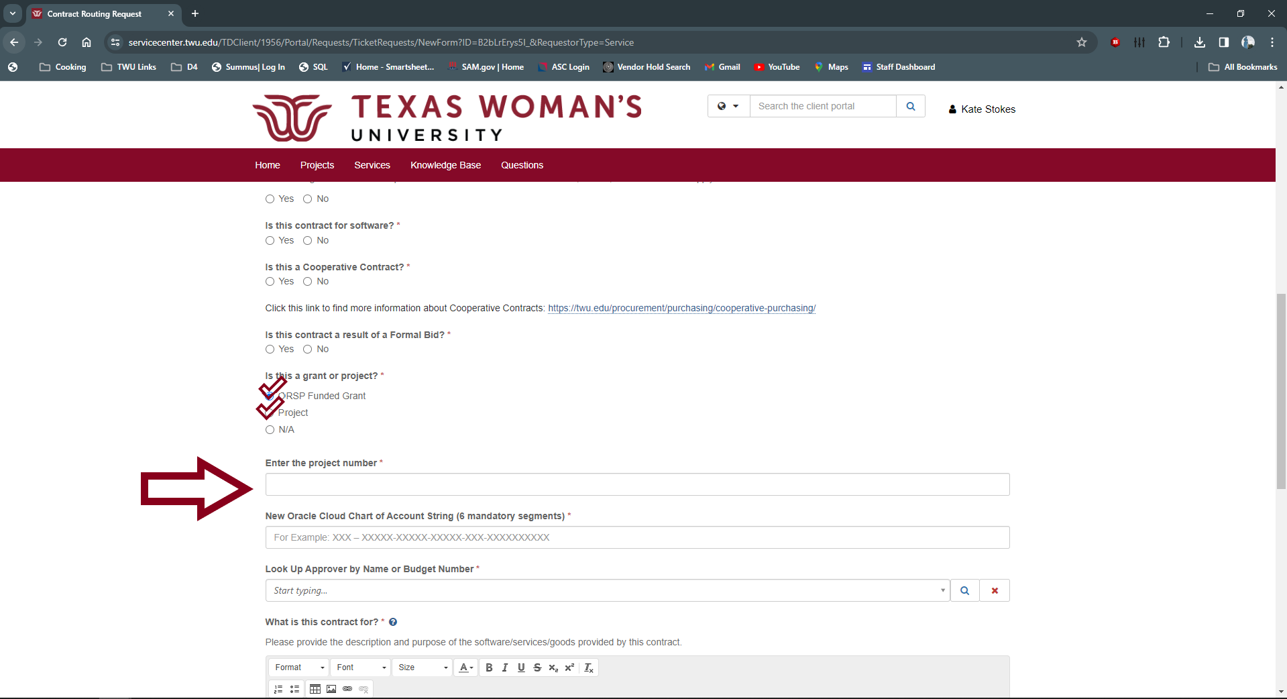
Grant or Capitol Funds
If this is for an ORSP Funded Grant or Capital Project, please provide the project number below.

Slide 42
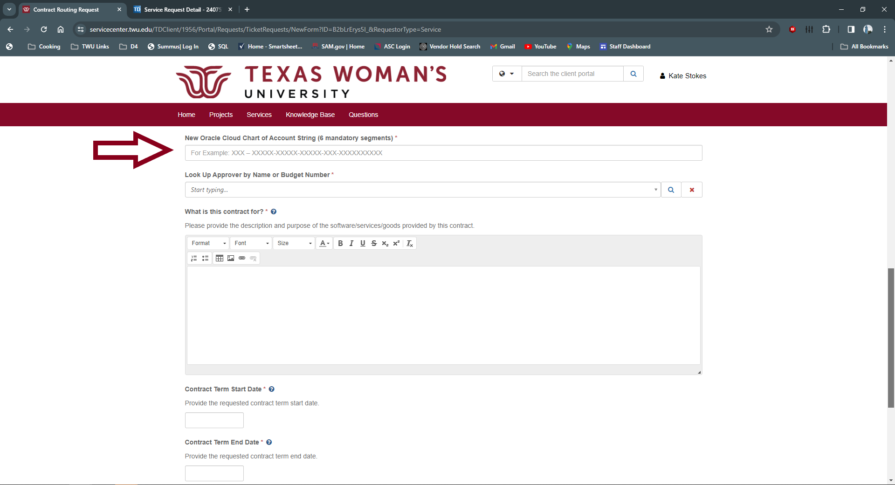
Oracle Cloud Chart of Accounts String
Add the Account String that the funding will be coming from. To download the Chart of Accounts, click here.

Slide 43
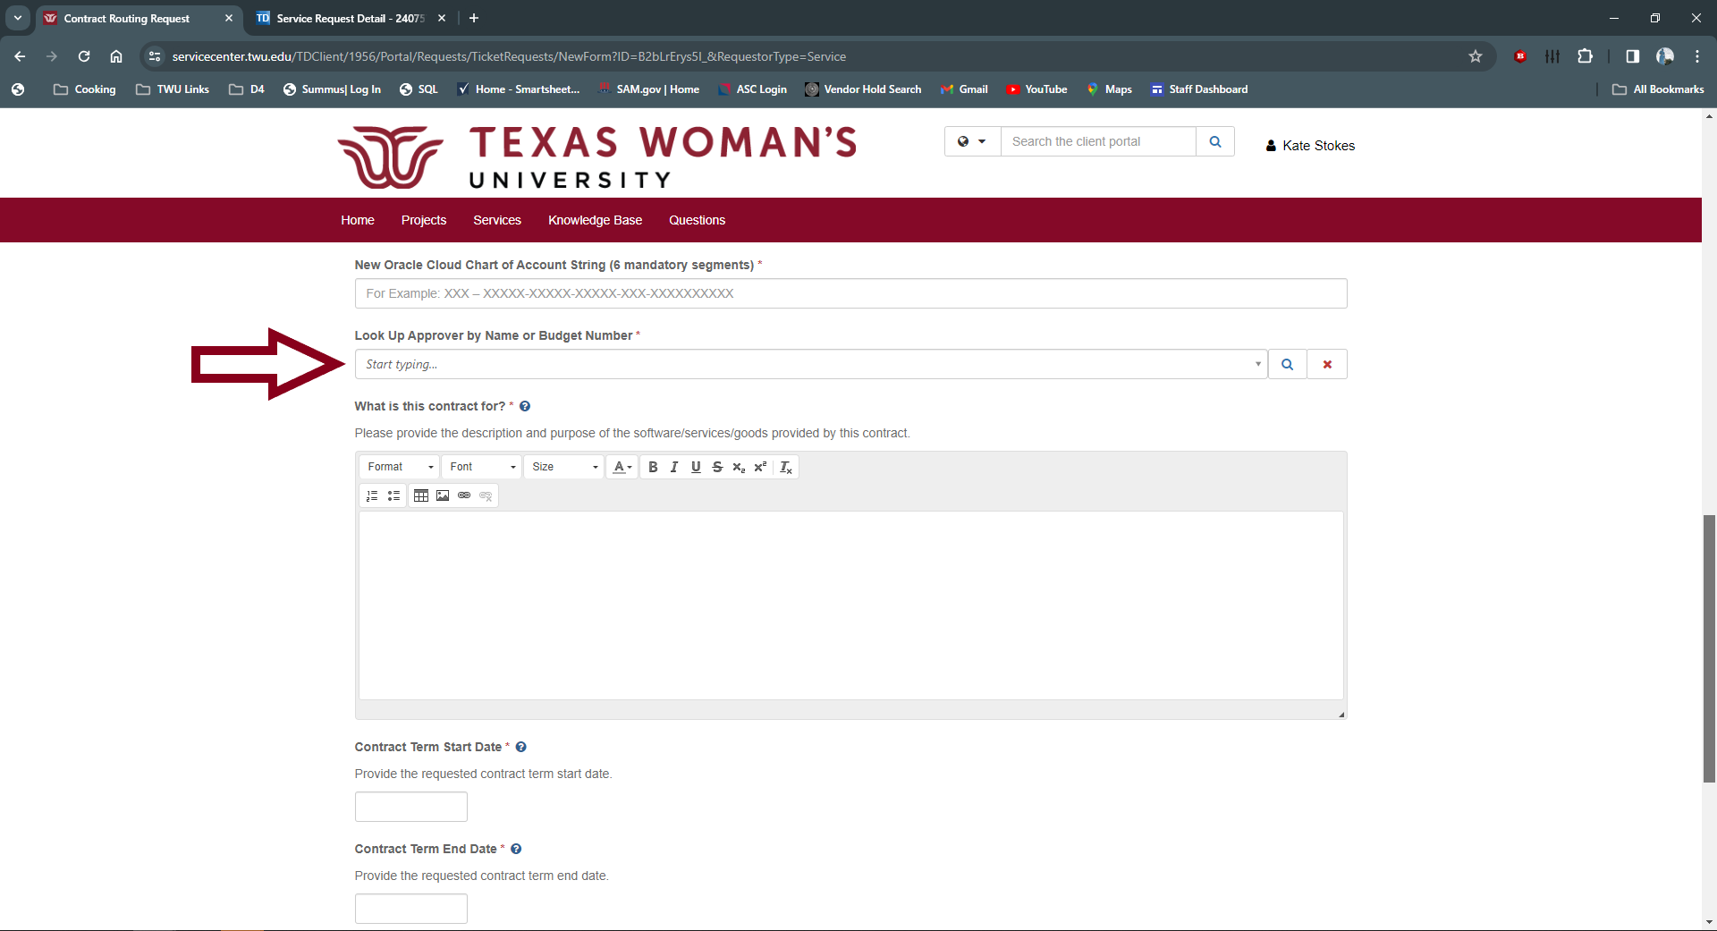
Account Approver
For the account string provided, please select your Account Approver. You can search for Account Approver by email or name. If unsure of approver, check Chart of Accounts here.

Slide 44
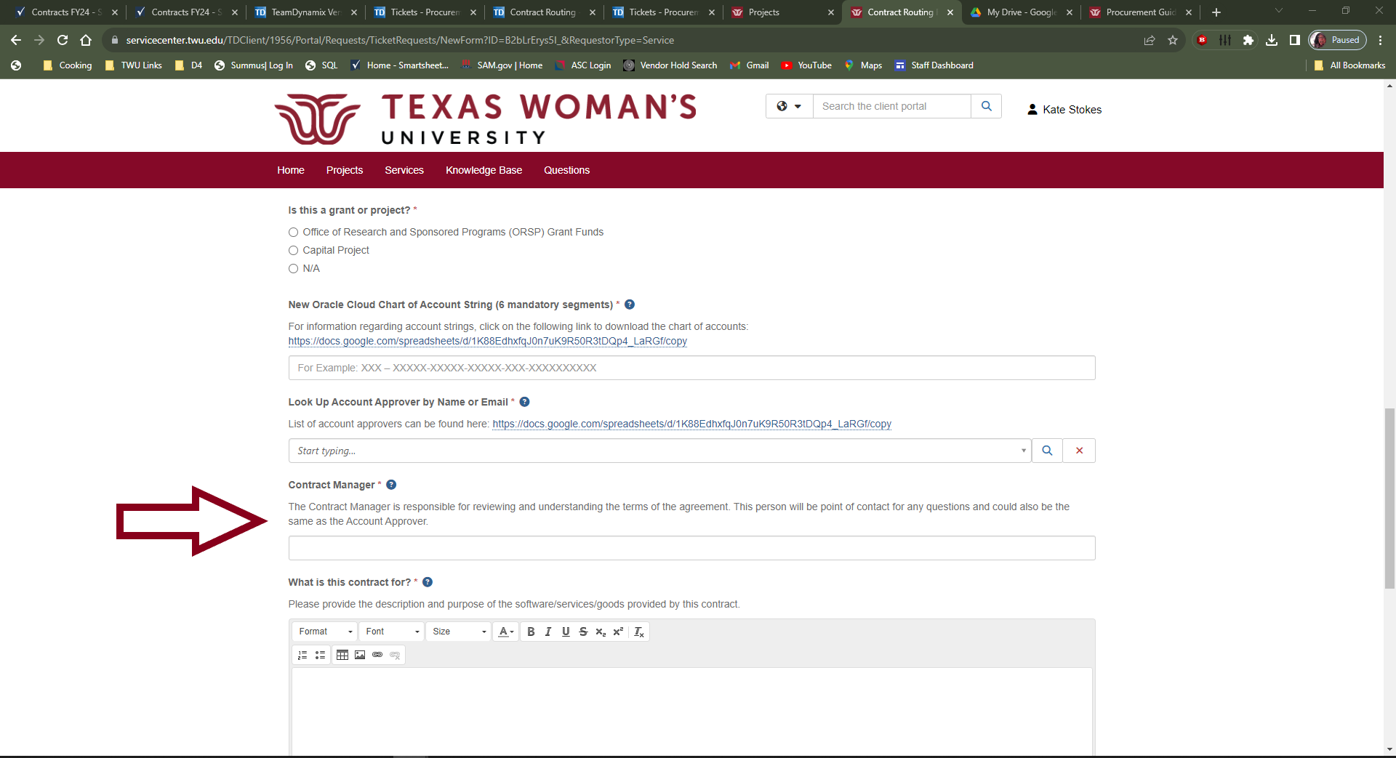
Contract Manager
The Contract Manager is responsible for reviewing and understanding the terms of the agreement. This person will be point of contact for any questions and could also be the same as the Account Approver.

Slide 45
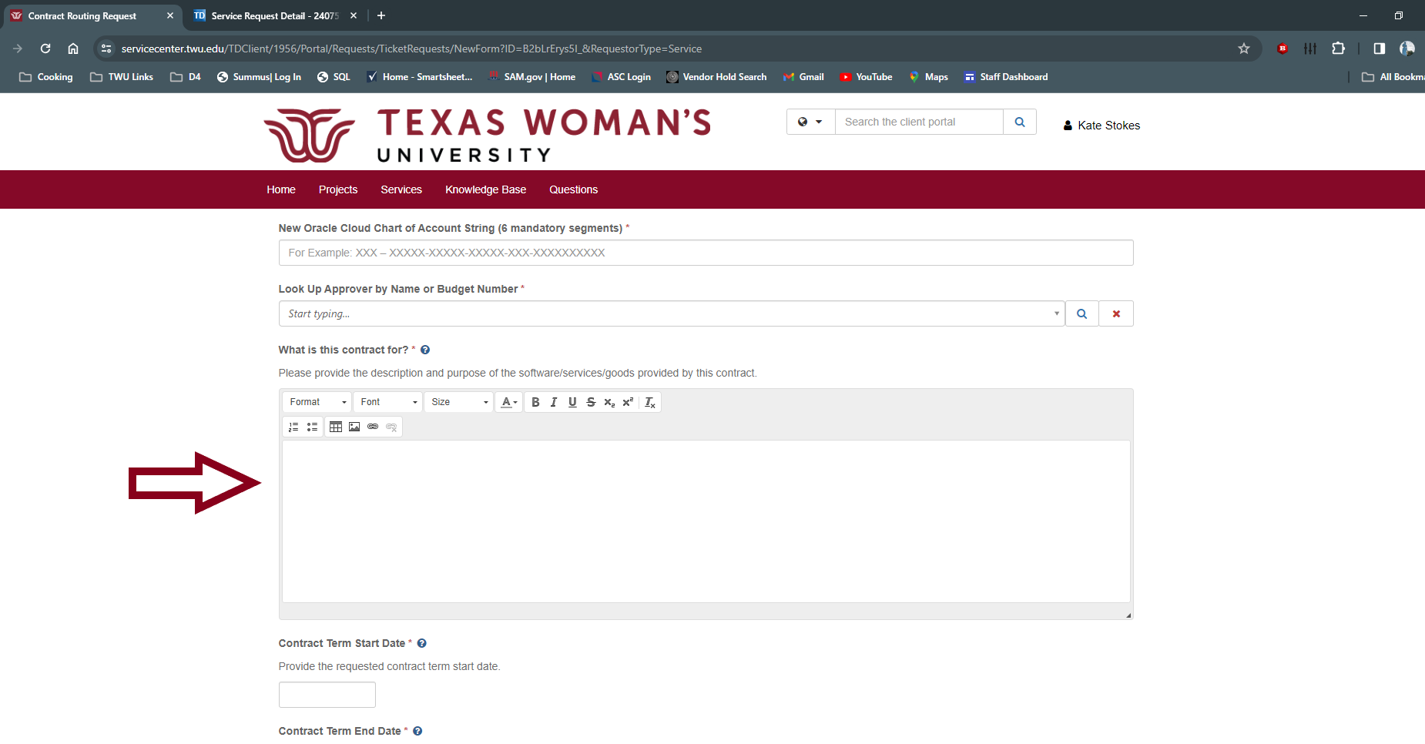
What is this contract for?
This should be a BRIEF description for what the contract is for. Keep it short and sweet.
Example – Guest Lecturer for Art History 4100, Oracle Cloud Software, Bounce House for Block Party, etc.

Slide 46
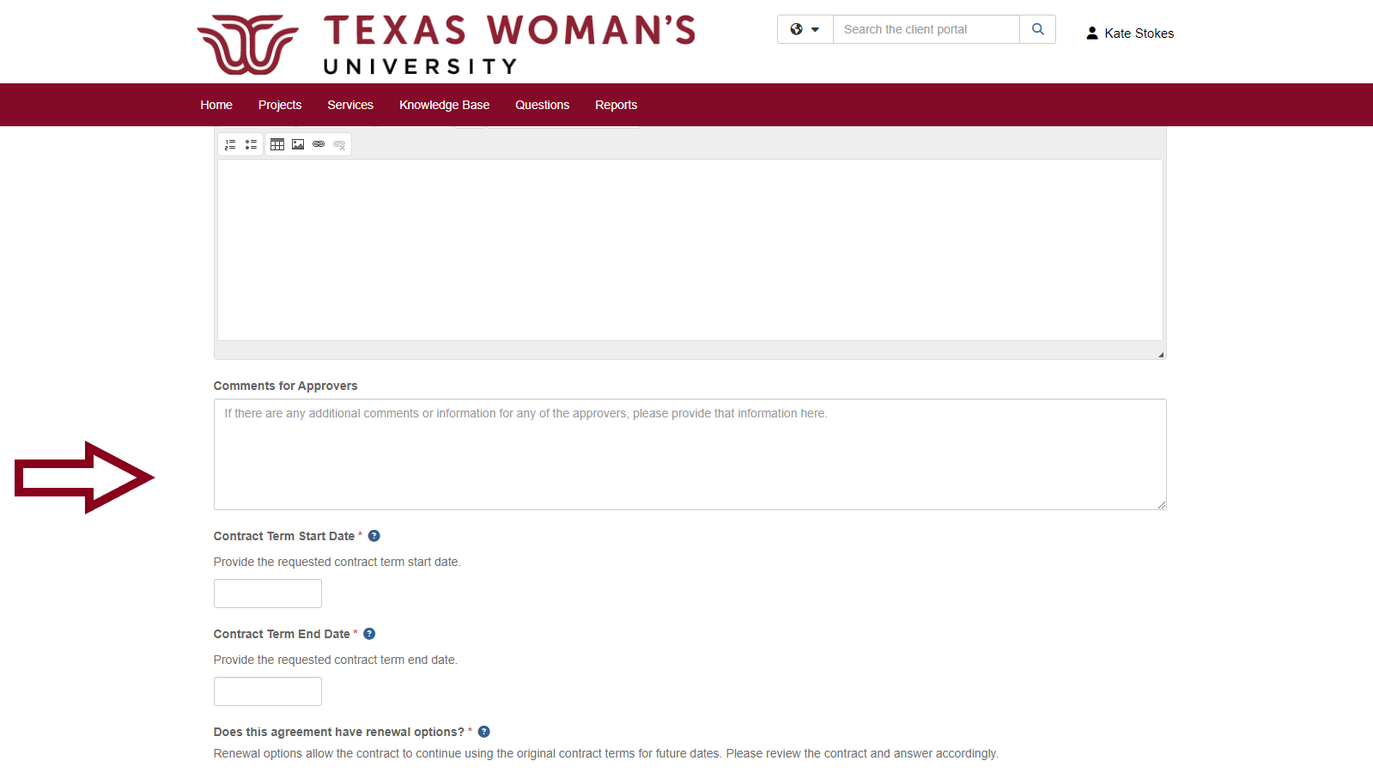
Comments for Approvers
If you have any helpful or additional information for any of the areas approving the agreement, please add it here.

Slide 47
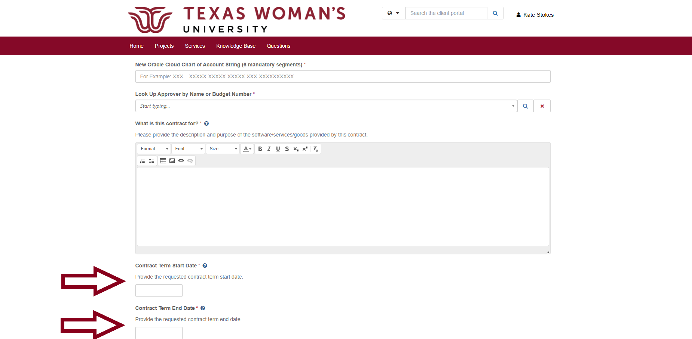
Term of Contract
Provide start and end dates for the agreement. If the contract is for a one day event (like a guest speaker or performer), put the day of the engagement for both start and end.

Slide 48
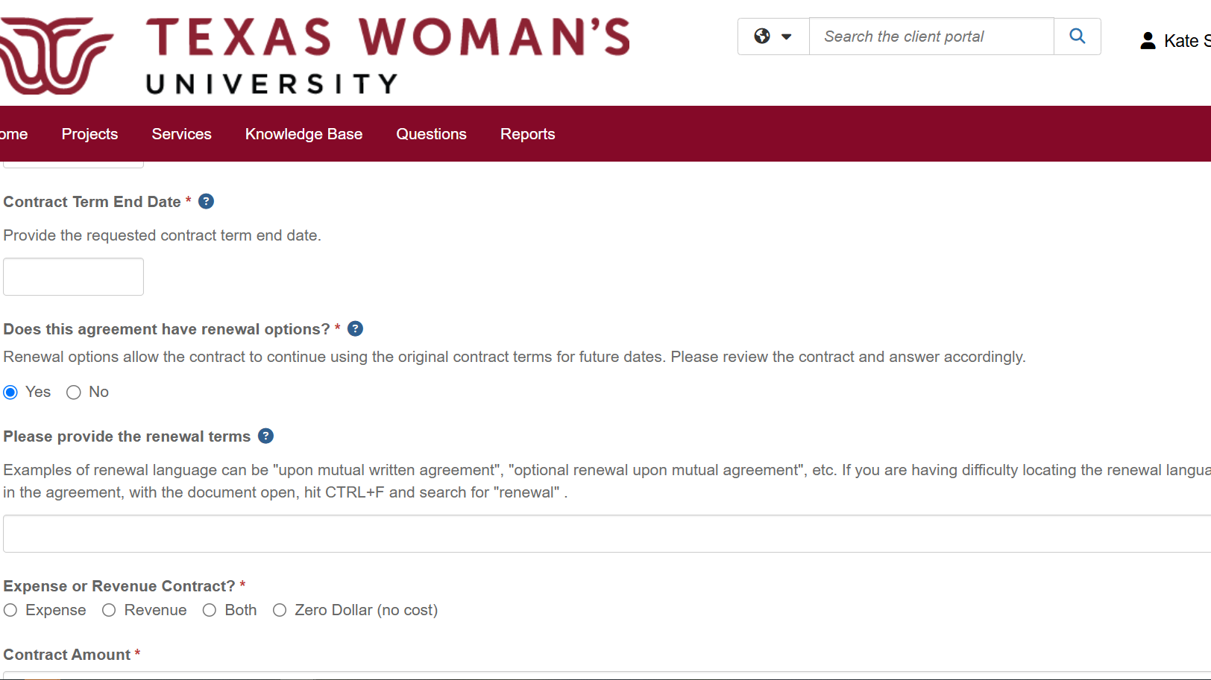
Renewal options
Sometimes agreements can have the option to extend the term of the agreement after the initial term has expired. We will need to know if there is renewal language within the document. Control + F searching for “renewal” is a good tip to find this!

Slide 49
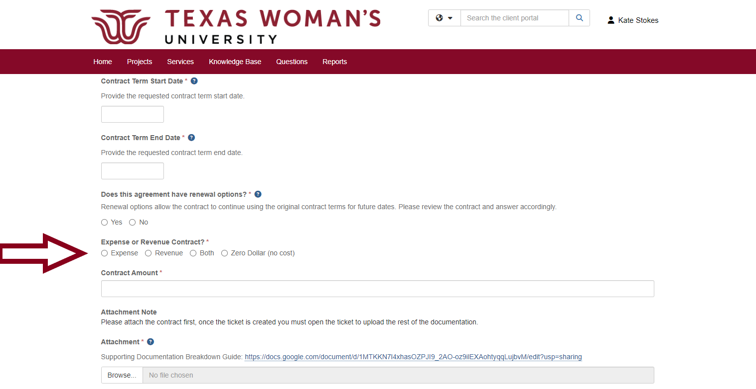
Expense /Revenue / Zero Dollar Agreement
If TWU is paying the Supplier, it is an expense.
If the Supplier is paying TWU, it is revenue.
If there is no cost, then it is zero dollar.

Slide 50
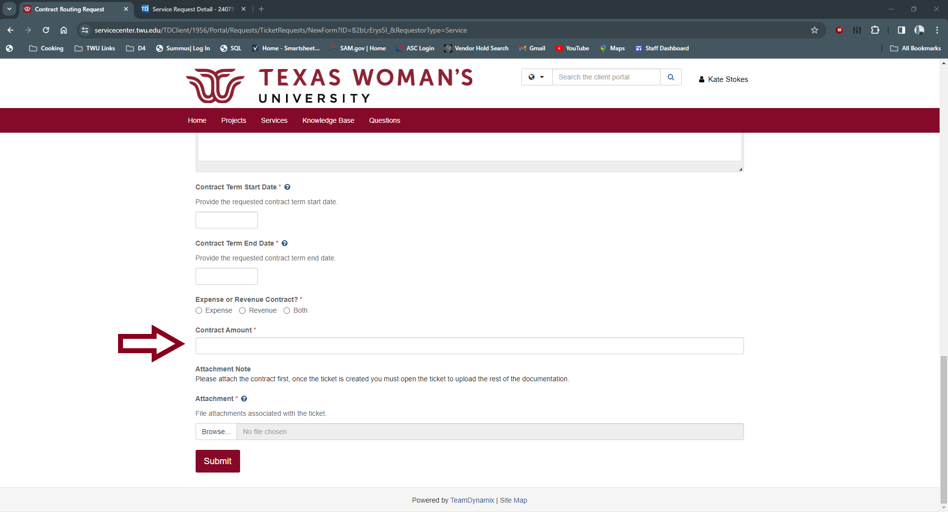
Contract Amount
Add the TOTAL amount of the agreement. If the contract doesn’t have a cost, the amount is zero dollar.

Slide 51
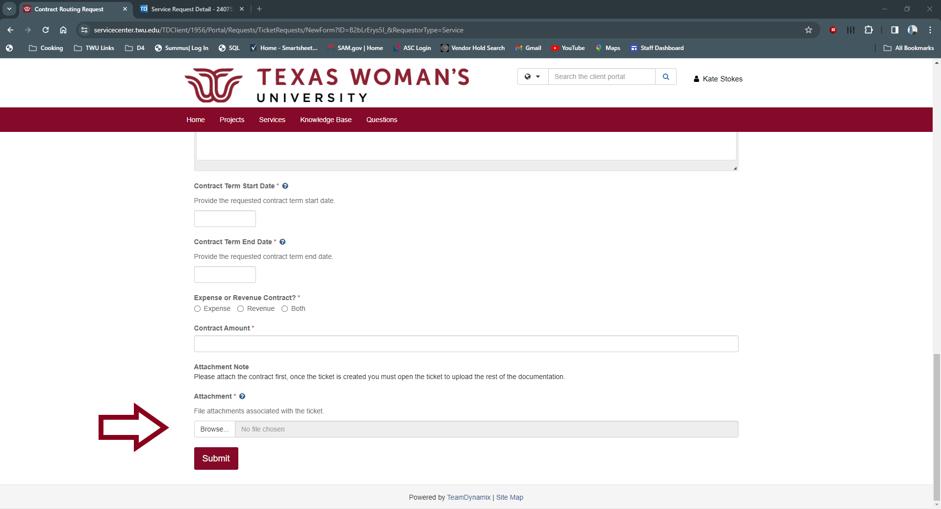
Adding Documents
Documents must be uploaded to the ticket when you submit.

Slide 52
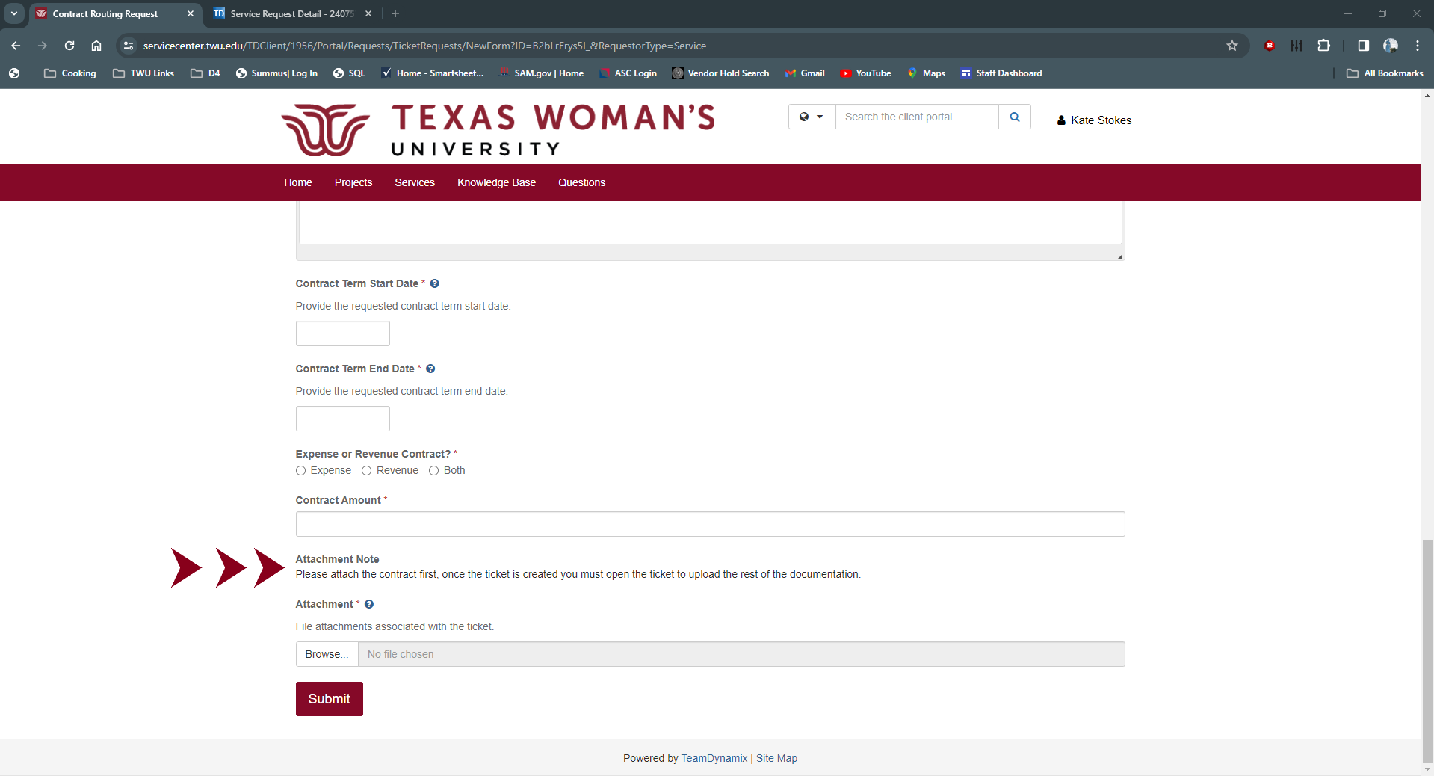
Upload Contract Document
Please attach your contract first. Once the ticket is created, you will need to upload the rest of your documentation.

Slide 53
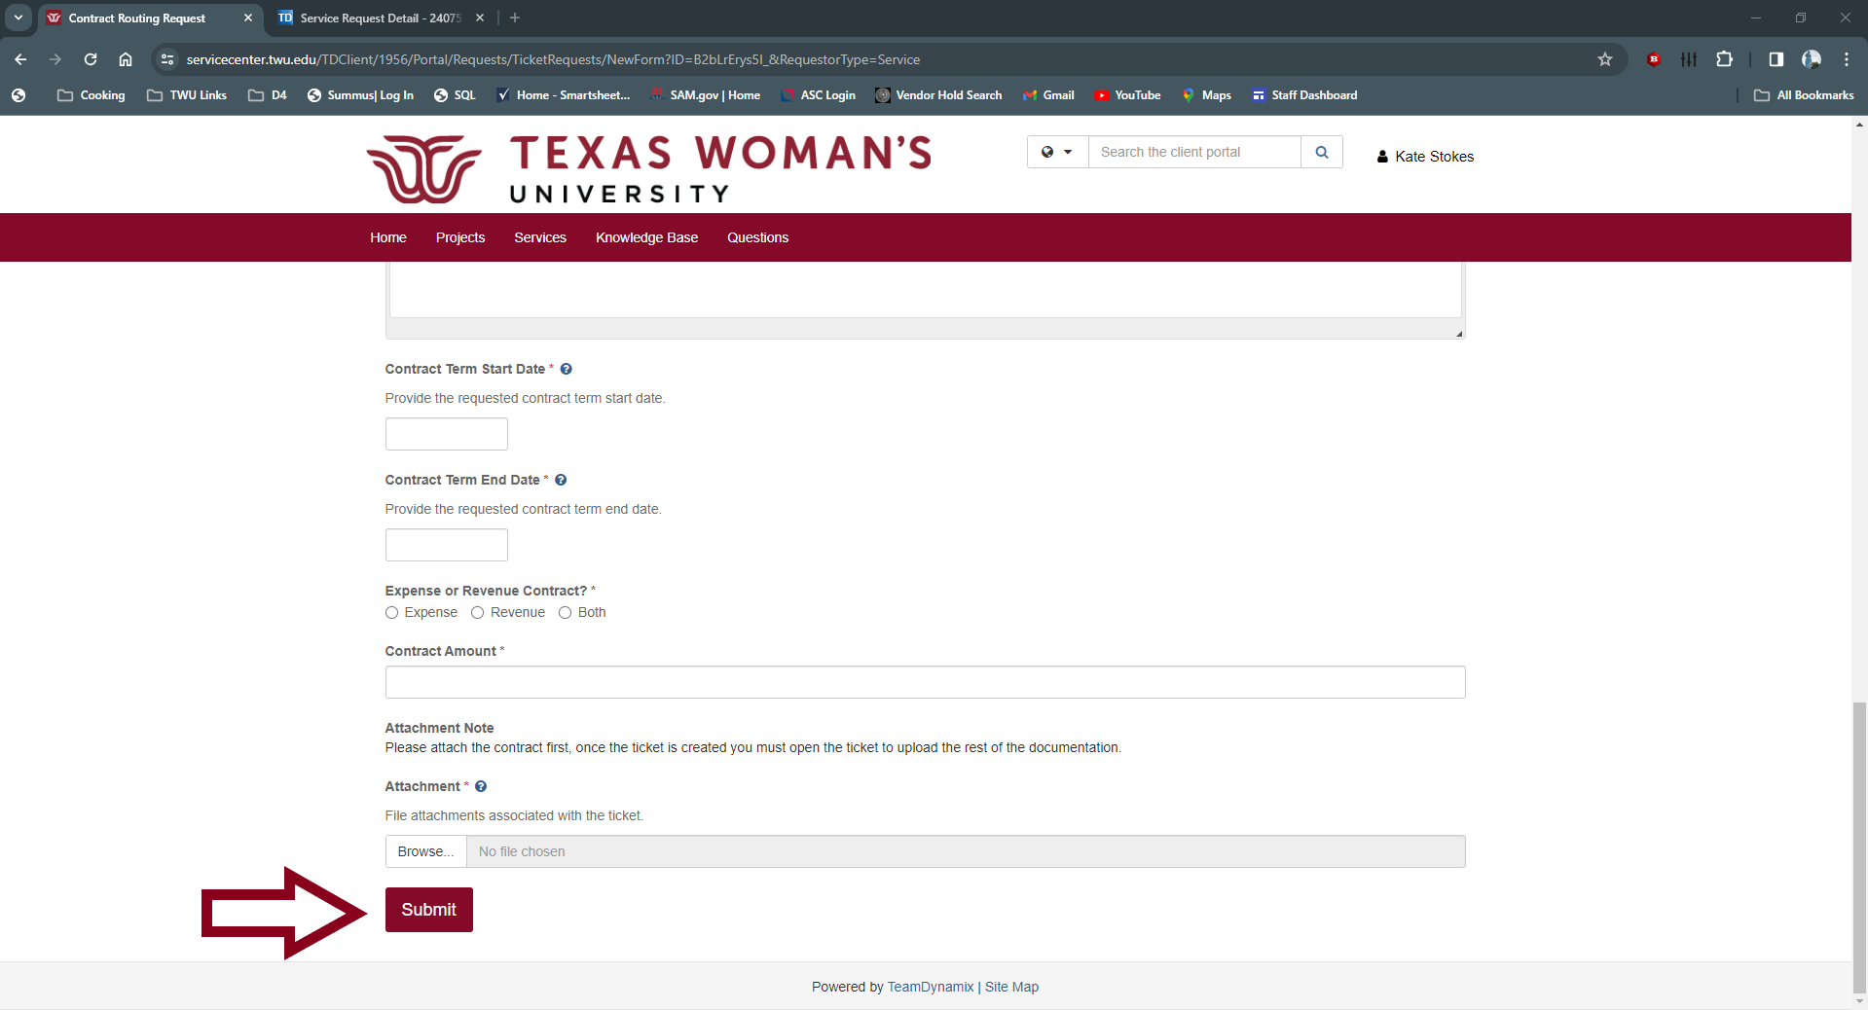
Pause before hitting submit
Double check that all your information is correct before hitting submit. Once you submit your ticket, you CANNOT make changes. Make sure your information is complete and you have all the required documentation before proceeding.

Slide 54
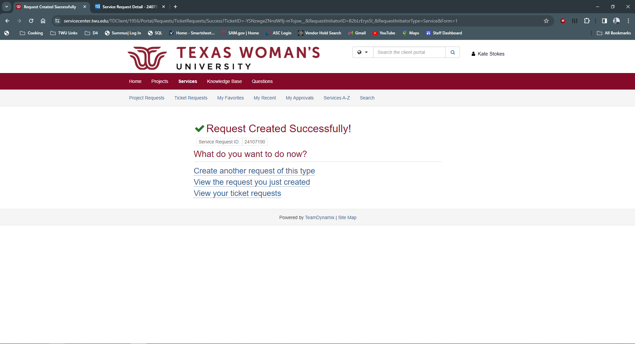
Ticket Confirmation Screen
You will get a confirmation screen if your ticket was submitted correctly. Keep track of your ticket number incase you need it.

Slide 55

Confirmation Email
You will also get an email confirmation when your contract has been submitted correctly.

Slide 56

Link to TeamDynamix Ticket
You can access your ticket by clicking on the link located in the confirmation email. This is super helpful and worth saving.

Slide 57

Add Supporting Documentation
To add the rest of your Supporting Documentation, click on “View the request you just created”

Slide 58

Adding documents to ticket
You can add the rest of your supporting documentation here. You can add documents by clicking the ‘+’ or by dragging and dropping to the Attachments Section on the right. We recommend clicking ‘+’ for larger documents.

Slide 59

Not sure what else you need to upload?

Slide 60
Supporting Documentation Breakdown!
There was! Supporting Documentation Breakdown is located on the landing page.

Slide 61
Naming of Documents
Keep it clean simple and informative.
For Example:
Contract – Supplier Name
Guest Lecturer Agreement – Supplier Name – Date of Event
Name of Supplier – Project Name – Project Number
Risk Assessment – Supplier Name
1295 – Supplier Name
What not to send in
124356785u6ytrewdfsgh.pdf
This_Name_is_so_long_its_going_to_break_my_hard_drive_when_I_try_to_save_this….
Untitled1.doc
Each piece needs to be uploaded separately. Do not send in one giant file will all your documents. Your ticket will be returned.

Slide 62

Welcome to your Ticket!
Here you can see all the details you entered as well as all the documents.

Slide 63

Ticket Status
Here you can see the status of your ticket. This status will be updated through the contract routing process

Slide 64
Statuses
New
Status of a new agreement entered into the ticketing system. This means it is still being reviewed and approved by Procurement.
On Hold – Department Correction Required
If correction to documentation or question is asked by Procurement to the department.
In Process
Procurement has approved the agreement and has routed to other TWU areas for review and approval.
Contract Routing Complete
The contract and all supporting documentation has been reviewed and approved. The contract is being sent out for signature.
Closed
The contract has been fully executed.
Contract Package Not Accepted – Correct and Resubmit
Contract package is has not been accepted by Procurement. This could be due to a number of factors. Review the corrections provided and resubmit your ticket with the requested corrections.

Slide 65
Statuses Continued
Sent for Legal Review
Contract has been submitted for legal review.
Legal Review – OGC Reviewing
Contract and/or edits are being reviewed by TWU’s Office of General Counsel.
Legal Review – Supplier Reviewing
Proposed edits and terms are being reviewed by the Supplier.
Legal Review – Pending Department Response
Office of General Counsel has questions for the department. Please answer them for the review to continue.

Slide 66

Workflow Steps
This will show you what area will be reviewing your agreement and where it is in the review process.

Slide 67

Your Feed
At the bottom of the ticket, you can read comments and updates from approvers. Action items that need correction and all questions should be addressed here.

Slide 68

Adding comments and uploading documents
It is extremely important to notify approvers when you make a comment or upload documents to the ticket. To make a comment and notify your approver, use the comment button. Do not comment directly to another comment. There isn’t a notify option.

Slide 69

Notify
After clicking the comment button, select who you want to notify.

Slide 70

Select who needs to be notified
You can select multiple people to notify. The Procurement Group is the Contract team (Kate Stokes and Jenny Keele). We will be on every ticket

Slide 71

Comments
Make your comments below and hit save. If you are uploading a document to the ticket, please comment and notify the Procurement Group. We will not be notified that you have uploaded your document unless you comment and notify us.

Slide 72
Notifications going to Junk/Spam
For Windows PC:
Open Outlook and navigate to "File."
Select "Manage Rules & Alerts."
Ensure that TDX is on the approved whitelist.
Check the box next to any rule that might be impacting email routing.
Click "Change Rule," choose the type of change needed, and follow the on-screen instructions.
For Mac:
Click on "Home" in the upper left corner.
Locate and click on the "Rules" icon.
Choose "Edit Rules" under the "Rules" icon.
Confirm TDX is on the approved whitelist.
Follow the on-screen instructions to add, edit, or delete Outlook email rules.
If users encounter any challenges or if the issue persists, I encourage them to reach out to the service desk for guidance (940) 898-3971. They are equipped to provide additional assistance and ensure a smooth resolution.

Slide 73
Department Responsibility
It is your responsibility to actively monitor, respond, and track the process of your contract’s approval and routing.
It is not the responsibility of Procurement to remind you.
Watch your notifications
Make sure you notify when you upload and comment
Check your statuses
Review landing page to see where it is in the process

Slide 74
Links and Guides
Procurement Contract Routing Ticketing System
https://servicecenter.twu.edu/TDClient/1956/Portal/Requests/ServiceDet?ID=53850
How to Guide for Contract Requestors
https://drive.google.com/drive/folders/1br7hPmz5-1PXpsQUXSw53sIAgh3rDeLI?usp=drive_link
How to Guide for Contract Account Approvers
https://drive.google.com/drive/folders/1OzPBxGjlW01aLwAY7RTglx29XHQagquX?usp=drive_link

Slide 75
Procurement Links
Contracts: https://twu.edu/procurement/contracts/
Forms and Instructions: https://twu.edu/procurement/forms-and-instructions/
Purchasing: https://twu.edu/procurement/purchasing/
Supplier Registration: https://twu.edu/procurement/supplier-registration/

Slide 76
Contracts Crew
Jamie Cogdell – jcogdell@twu.edu
Director, Purchasing and Contracts
Jenny Keele – jkeele@twu.edu
Coordinator Contract Services
Kate Stokes – Kstokes3@twu.edu
Procurement Generalist/HUB Assistant

