Slide 1
Thesis & Dissertation Workshop

Slide 2
A Brief Overview of the Process
After you defend your dissertation, you will submit your edited document to your academic component leader (department chair). Once they have granted approval, you will submit to the Graduate School to Vireo.
The Reader will review your dissertation first, and then the Formatter after you have made your Reader corrections.
Once all corrections have been made, you will see Graduate School approval.

Slide 3
A Note About the Process
The review process is to check for “quality control and professionalism” (Graduate Catalog).
We are not editing and formatting your document on your behalf. Though we are here to assist and provide resources, these are still your responsibility.

Slide 4
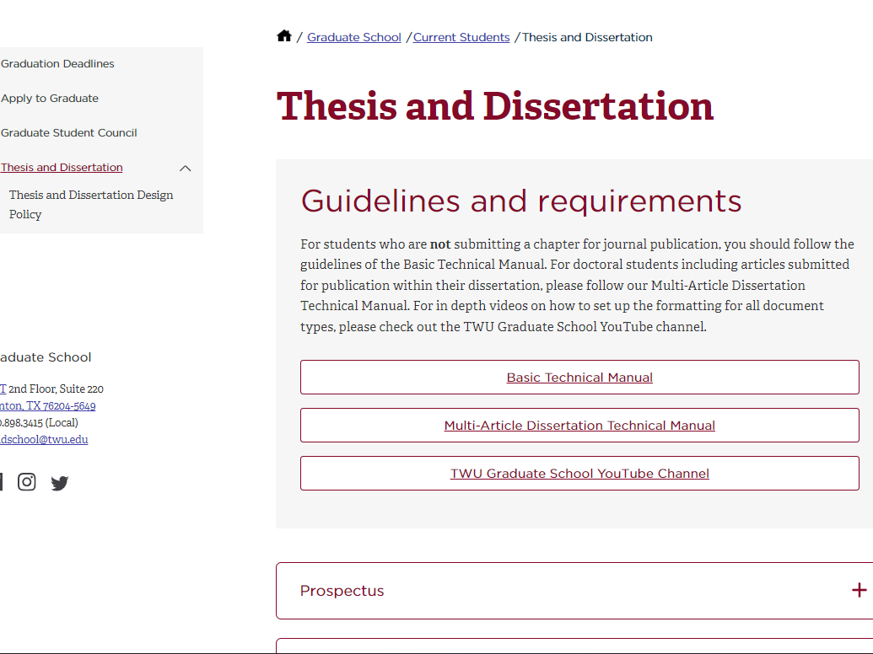
Graduate School website
Current Students -> Thesis & Dissertation
https://twu.edu/

Slide 5
New Technical Manual
Basic
Multi-Article
Use if you are not including a submitted/published article
Comprehensive reference list
Use if you are including a submitted/published article
Reference list after every chapter, no comprehensive list
Required to submit journal guidelines, co-author permissions, author agreement

Slide 6
Graduate School YouTube Channel
Formatting playlist
Common Comments playlist
Using Vireo playlist

Slide 7
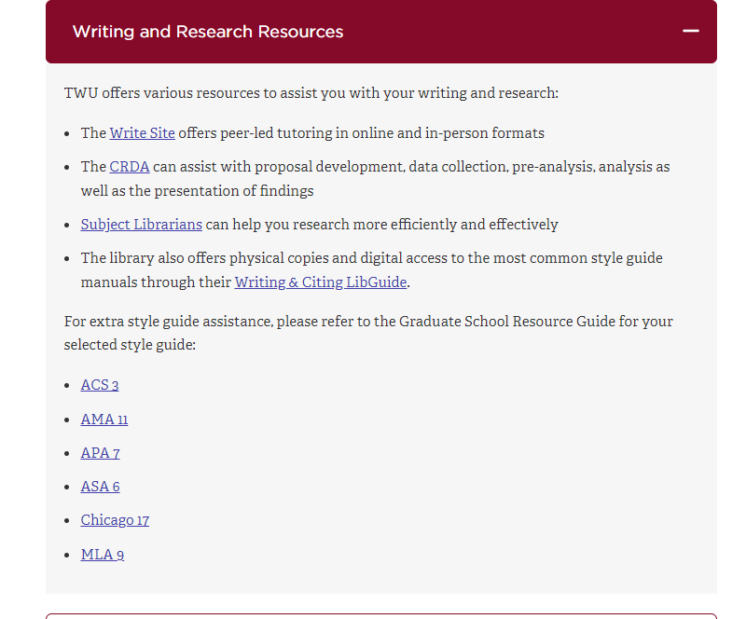
Other Resources
Writing assistance: TWU Write Site, Resource Guides ->
Research design assistance: TWU CRDA, Subject Librarians
De-stress: Health & Wellbeing Initiative

Slide 8
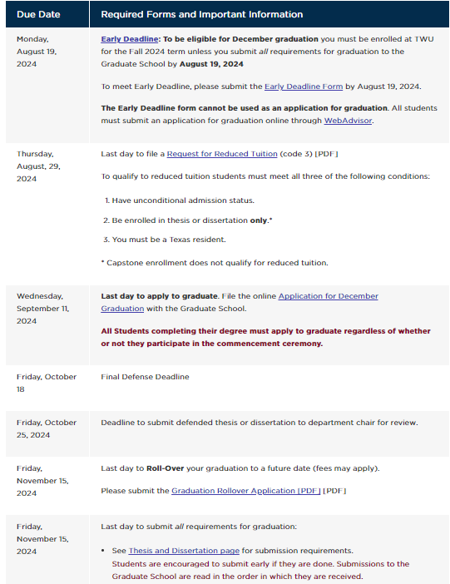
Give Yourself Time
The biggest mistakes we see are a result of rushing and procrastinating
Plan ahead to give yourself enough time to carefully and closely edit your document before you submit to the Graduate School. It will end up saving you a lot of time in the long run!

Slide 9
Common Mistakes - Reader Review
Inconsistency
Incorrect citations/references
Style guide specific: abbreviations, number rules, verb tenses

Slide 10
Common Mistakes - Formatter Review
Table of Contents
Spacing
Cover Page
Not reviewing the PDF after converting
the Word document

Slide 11
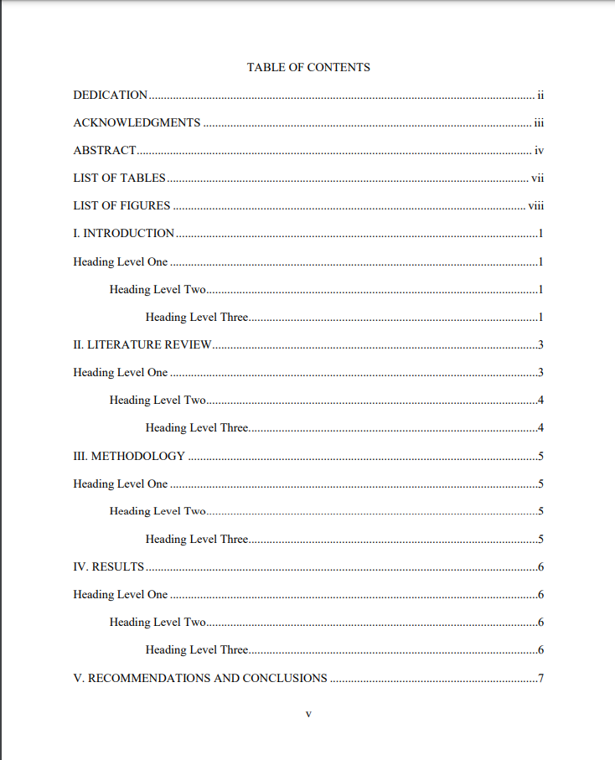
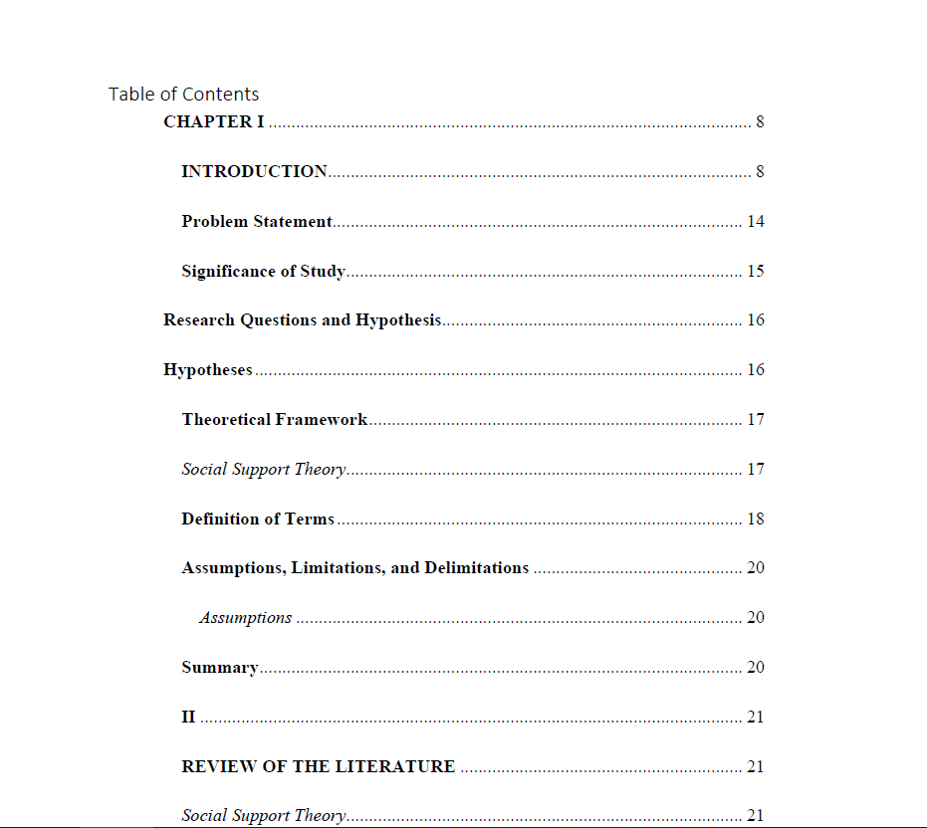
Table of Contents Examples: One Correct, One Incorrect
Visually compare your formatting to the Technical Manual. It’s okay if you don’t catch everything, but take your time and double check to make sure they are consistent!

Slide 12
So How Should You Avoid These?
Take your time - Work carefully when you’re editing your document (the same goes for when you’re going through our feedback).
Read out loud - Your eyes skip over mistakes because you’ve looked at the document for so long. Reading out loud will draw attention to mistakes.
Double & triple check - Especially when it comes to citations/references and formatting

Slide 13
A Few Additional Tips
If using a citation generator, be careful entering the information and double check the reference it provides for accuracy.
Don’t use department created formatting templates or past dissertations for formatting. Requirements often change or allowances are made on a case-by-cases basis.
Remind yourself that you’re almost at the end!

Slide 14
Appointments & Meetings
Depending on the time in the semester, we may not be able to agree to a meeting.
However, if you provide us with your questions via email, we can usually respond with 24-48 business hours.

Slide 15
Questions?
Contact: Jaclyn Kliman, Reader
jkliman@twu.edu
Caroline Scott, Formatter
mscott34@twu.edu

