Slide 1
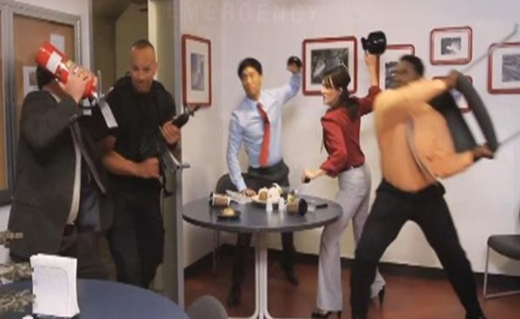


Be Pioneer Prepared: Active Shooter Awareness
2017/2018

Slide 2
Agenda
Be Pioneer Prepared!
Background on Active Shooter Events
Be Aware
Response
Next Steps
Questions

Slide 3
Be Pioneer Prepared!

Slide 4
Personal Preparedness Plan
Make a plan
Take time to speak with your family members and friends
Create a communication plan
Identify out-of-town contact
Phone number for each family member or friend
Designate a meeting place or rally point
Document critical information about each family member or friend
Name
Work location and phone number
Important medical information (Ex: Medications)
Identify evacuation routes both at work/school and at home
Determine what you need in your disaster kit and put it together
First aid kit
Medication
cell phone charger

Slide 5
Background on Active Shooter

Slide 6
Definition of Active Shooter
One or more people engaged in attempting to kill as many people as possible
Often go for an area where there is a large target or gathering of people
Usually the individuals targeted are random
Different than a hostage situation

Slide 7
Statistics
1994-2006
Average of 3 school shooter/year in US
42 total
Post Virginia Tech (2007-Present)
Average of 16 school shootings/year
110 total

Slide 8
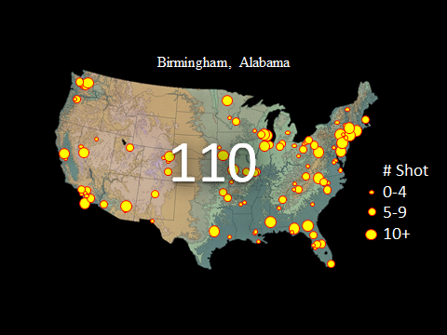

Statistics
1994-2006
Average of 3 school shooter/year in US
42 total
Post Virginia Tech (2007-Present)
Average of 16 school shootings/year
112 total

Slide 9
Profile of an Active Shooter
There is no distinct profile
However, there are signs
Threats made on social media
Clues hidden in school work
Drastic changes in behavior

Slide 10
Be Aware

Slide 11
Survival Mindset (Situational Awareness)
Personal Responsibility = Situational Awareness
Survival Mindset Stages:
Unaware (Not a place to be)
Relaxed but alert (Ideal to be in at all times)
Something appears wrong (When you seen an issue)
Taking action/fight or flight (Decision-making stage)
Panic, over reaction, under/no action (Result of Unaware)

Slide 12
Three Stages of Disaster
Denial
Hear something that sounds like gunshots or a popping noise, then go straight to deliberation
Do not dismiss
Deliberation
Must quickly make a choice
Realize stress could slow decision-making ability
Take deep breaths to calm self
Scripting and practicing
Decisive Moment
Taking action
Acting with purpose and fully committing to actions

Slide 13
Response

Slide 14
Taking Action
When to Report to DPS
Anytime a person threatens to commit or commits an act of violence
Abuses or threatens a person
Uses abusive, profane, or vulgar language
Prevents or disrupts use of the building
Places individuals in fear of injury

Slide 15
Taking Action
Notification of an Active Shooter event on campus
Hearing gunshots (If in the same building or close proximity)
Receiving Pioneer Alert (We never send these out as a drill! If you get this it is real!)
Phone (Text/voice)
Email
Social media (@PioneerAlert)
Desktop
Homepage
Update Pioneer Alert information through Pioneer Portal
*Lockdown sign
Be careful who you let in a locked door. It may be the shooter!

Slide 16
Taking Action
Remember these steps (If in building with assailant)
Run
Get out of the building if safe and possible
Once in a safe area outside of the building, call DPS to report
Description of assailant
Location of the shooting
Do not provide information you don’t have
Hide (If unable to get out)
Lock yourself in a room and barricade door with heavy objects
Turn off the lights and remain completely silent
Do not use cell phone ( You want it dark and quite)
Fight
Distractors and attackers
Do not huddle for comfort instead spread out
Fully commit to action

Slide 17
Taking Action
If not in the building with the shooter:
Maintain situational awareness
Stay off campus
Do not come on campus until it is safe
Notification from Pioneer Alert
We will send an “All Clear Message” when you can resume normal activities

Slide 18
Police Response
Priority for police
Find the threat and stop it
Do not expect them to stop to provide medical assistance (First team will step over wounded to go after the threat. The next team will attend to the wounded)
Do not expect them to be able to speak with you in detail
When police arrive:
Follow commands
Show your hands
Do not make any sudden or aggressive movement toward them (Do not know who is a threat)
We are looking for the threat to stop the damage as soon as possible

Slide 19
Medical Response
EMS
Will be delayed until it is safe for them to enter a part of the building, but other officers come in to give aid
Provide first aid if possible to those who were injured
Seek training for first aid

Slide 20
Next Steps
Starts with prevention
Get to know your campus community
Be mindful of other’s behavior and do not hesitate to refer if concerned

Slide 21
Active Shooter Video
https://www.youtube.com/watch?v=XsE_JdzpAbI

Slide 22
Contact Information
Lt. Jennifer Niederhaus Department of Public Safety
Texas Woman’s University
Phone: 940-898-2929
Email: jniederhaus@twu.edu
Website: www.twu.edu/DPS
Sgt. D. Bundick
Department of Public Safety
940 898-2911
dbundick@twu.edu

Slide 23
Questions?

