Slide 1
Writing SLOs for Course Proposals
Terry A. Senne, Ph.D. & Gray Scott, Ph.D.
September 18, 2020

Slide 2
Workshop Outcomes
By the end of today’s workshop, participants will be able to
  Provide accurate and specific feedback on course proposal SLOs.
  Adapt or create one’s own course proposal SLOs in accordance with TWU guidelines.

Slide 3
A Big-Picture Scenario
Scenario: The computer science department and the School of Business have created a small certificate program in Software Leadership. The program has three required courses and one choice of two courses. Its four program objectives are usually summarized by faculty as Management, Coding, Elicitation, Documentation.
Activity

Slide 4
A Big-Picture Scenario
In AY 2018-19’s capstone assessments, the percentage of students meeting each objective were as follows:
CAPSTONE ASSESSMENTS | Meets Exit Competency
Management | 84%
Elicitation | 33%
Documentation | 77%
Coding | 92%
SLO 2 (Elicitation): By the end of the program, successful students will be able to clearly and accurately describe client software needs based on interviews with those clients.
Activity

Slide 5
A Big-Picture Scenario
Software Leadership Curriculum Map
Software Leadership | Management | Elicitation | Documentation | Coding
CSCI 301 (required) |  |  | 3 | 3
CSCI 302 (required) |  | 2 | 2 | 2
CSCI 303 (choice A, 20%) | 2 | 3 |  | 1
CSCI 304 (choice B, 80%) | 2 |  | 1 | 3
BUS 302 (required) | 3 | 1
Activity
3: Primary emphasis, 2: Secondary emphasis, 1: Tertiary emphasis.

Slide 6
A Big-Picture Scenario
Software Leadership: Elicitation Activities by Course
CSCI 302:
  Lectures on principles of interviewing
  Quizzes on those principles.
  Low-stakes, practice in-class: Students pair up and trade off being "client" and "interviewer." Clients receive a handout describing their needs.
CSCI 303:
  Students regularly practice writing elicitation documents based on pre-recorded interviews.
  Practice documents are regularly reviewed and revised in class.
  For final project, student teams interview faculty playing “client” according to a trained script. The interview sessions are recorded. Teams create elicitation documents.
  Teams with weak elicitation documents meet with faculty to review the recorded interview and determine where they went wrong.
BUS 302:
  Final project is based on pre-recorded client interview.
  Elicitation documents included in appendix of final project and scored for factual accuracy.
  The same assignment and the recorded interview for this project have been used consistently for four years.
Activity

Slide 7
A Big-Picture Scenario
Discussion: Why did we start with this activity?
Activity

Slide 8
Making a SLO
Principles of SLO Cooking
Action Verb Levels & Coloring Outside the Lines
Workshop on Your Own SLOs

Slide 9
Evaluating SLOs
The professor will provide opportunities for active learning through three experiential field trips.
Students will practice brainstorming, outlining, peer review, and revision.
By the end of the course, successful students will appreciate Shakespeare.
Activity

Slide 10
Principles of SLO Cooking, Part 1
A good SLO focuses on what a
  student
  successfully completing the class
  should be able to do.

Slide 11
Principles of SLO Cooking, Part 1
A good SLO focuses on what a
  student
  successfully completing the class
  should be able to do.
Not a teacher!

Slide 12
Principles of SLO Cooking, Part 1
A good SLO focuses on what a
  student
  successfully completing the class
  should be able to do.
That is: At the end of class.

Slide 13
Principles of SLO Cooking, Part 1
A good SLO focuses on what a
  student
  successfully completing the class
  should be able to do.
This is the tricky one:
Not knowledge, but what can they do with the knowledge.

Slide 14
Principles of SLO Cooking, Part 1
A good SLO focuses on what a
  student
  successfully completing the class
  should be able to do.
This is the tricky one:
Not knowledge, but what can they do with the knowledge.
Not a process, but what that process enables them to accomplish.

Slide 15
Principles of SLO Cooking, Part 1
A good SLO focuses on what a
  student
  successfully completing the class
  should be able to do.
This is the tricky one:
Not knowledge, but what can they do with the knowledge.
Not a process, but what that process enables them to accomplish.
In other words, what exit competencies should students possess?

Slide 16
Principles of SLO Cooking, Part 2
A good SLO is
  measurable
  detailed and specific
  active

Slide 17
Principles of SLO Cooking, Part 2
A good SLO is
  measurable
  detailed and specific
  active
Put another way: Can the learning, as it’s framed here, be identified or observed? (It’s difficult to tell whether someone honestly appreciates literature, for instance.)

Slide 18
Principles of SLO Cooking, Part 2
A good SLO is
  measurable
  detailed and specific
  active
Other types of aspirations, like goals, might be general and broad (“We want students to be life-long learners”), but a SLO points directly at something that the student should be able to do.

Slide 19
Principles of SLO Cooking, Part 2
A good SLO is
  measurable
  detailed and specific
  active
The key here is the verb: In general, you want an action verb, like the ones categorized in Bloom’s Taxonomy.
Verbs like define, explain, evaluate, create, compare, design.

Slide 20
Components of Student Learning Outcomes
It’s simple – Just remember your ABCCs!
  A = Actor (sometimes referred to as the stem) Identifies who will do the behavior, e.g. “The student will be able to…”
  B = Behavior (sometimes called an action verb) Identifies what the student will be able to do. Use Bloom’s Taxonomy.
  C = Conditions (specific details) Identifies context/setting and/or conditions under which the behavior will occur.
  C = Criteria (often signified by an adverb) Identifies the minimum acceptable level of performance.

Slide 21
Components of Student Learning Outcomes
It’s simple – Just remember your ABCCs!
  A = Actor (sometimes referred to as the stem) Identifies who will do the behavior, e.g. “The student will be able to…”
  B = Behavior (sometimes called an action verb) Identifies what the student will be able to do. Use Bloom’s Taxonomy.
  C = Conditions (specific details) Identifies context/setting and/or conditions under which the behavior will occur.
  C = Criteria (often signified by an adverb) Identifies the minimum acceptable level of performance.
Conditions shouldn’t be so specific about assignment details that they infringe on academic freedom of faculty.

Slide 22
Components of Student Learning Outcomes
It’s simple – Just remember your ABCCs!
  A = Actor (sometimes referred to as the stem) Identifies who will do the behavior, e.g. “The student will be able to…”
  B = Behavior (sometimes called an action verb) Identifies what the student will be able to do. Use Bloom’s Taxonomy.
  C = Conditions (specific details) Identifies context/setting and/or conditions under which the behavior will occur.
  C = Criteria (often signified by an adverb) Identifies the minimum acceptable level of performance.
Criteria shouldn’t be so specific that they infringe on academic freedom related to grading.

Slide 23
Is This SLO measurable?
Why or why not?
By the end of the program/course/lesson, students will be able to
  Select the most appropriate investigative methods or information retrieval systems for accessing needed information.
Activity

Slide 24
Sample Identification of SLOs Components
By the end of the program/course/lesson, students will be able to…
  Select the most appropriate investigative methods or information retrieval systems for accessing needed information.
  Actor – Students
  Behavior – Select investigative methods or information retrieval systems
  Conditions – For accessing needed information
  Criteria/Criterion – Most appropriate
  This SLO is measurable since it contains all 4 components.

Slide 25
Is This SLO measurable?
Why or why not?
By the end of the program/course, students will be able to
  Effectively communicate interpretations of theatrical material in one or more of the following media: orally, in writing, and/or through dramatic performance.
Activity

Slide 26
Bloom’s Taxonomy of Educational Objectives
Action verbs help to ensure that a student learning outcome is measurable.
Bloom’s Taxonomy is a hierarchical design of ways of thinking (action or performance verbs), and classifies learning/cognition into 6 levels from less complex to more complex.
  Level 1 – Know
  Level 2 – Understand *
  Level 3 – Apply
  Level 4 – Analyze
  Level 5 – Evaluate
  Level 6 – Create
Due to the hierarchical design of the taxonomy, action verbs from lower levels of the taxonomy can be inferred at higher levels of the taxonomy.

Slide 27
Rules of Thumb – Action verb selection
Avoid use of verbs like know, understand, recognize, value, demonstrate, or appreciate, unless you describe the student performance actions that will indicate their knowledge, recognition, value, appreciation or ability to demonstrate.
  Note that once you’ve described the performance actions necessary to indicate those qualities, you may discover you no longer need the weaker verbs.
Keep SLOs simple – best to use one action verb per SLO.
Notes:
Go back, to previous slide 12 and modify one of the SLOs to make it measurable (contains all 4 components).

Slide 28
How can we make this SLO more measurable?
By the end of the program/course/lesson, students will be able to…
  Recognize appropriate concepts and theories of motivation to achieve group and organizational goals
Activity

Slide 29
What levels of action verbs are appropriate for designated course levels?
SACS-COC Accreditation Principles Section 9.6 states that, “Post-baccalaureate professional degree programs and graduate degree programs are progressively more advanced in academic content than undergraduate programs…”
How can you determine which action verbs are appropriate given a designated course level?

Slide 30
What levels of action verbs are appropriate for designated course levels?
  IN GENERAL: Higher course level = higher-level action verbs from Bloom’s Taxonomy
    One would expect 3000 and 4000-level course SLOs to include action verbs derived from the higher levels of Bloom’s Taxonomy (Levels 4-6).
    Graduate course SLOs would typically reflect action verbs found at the most complex levels of the taxonomy (Levels 5 & 6).
  But not always! →

Slide 31
When You Need to Color Outside the Lines
Low-level verb, but advanced predicate or object
  The student will be able to explain quantum mechanics in a two-page essay.
  (It’s tougher to identify the cause of a symptom than to create a mud pie.)

Slide 32
When You Need to Color Outside the Lines
Same verb, different objects at each level of a sequence
  The student will be able to write a personal narrative.
  The student will be able to write a business letter.
  The student will be able to write a literature review.
  The student will be able to write a grant proposal.

Slide 33
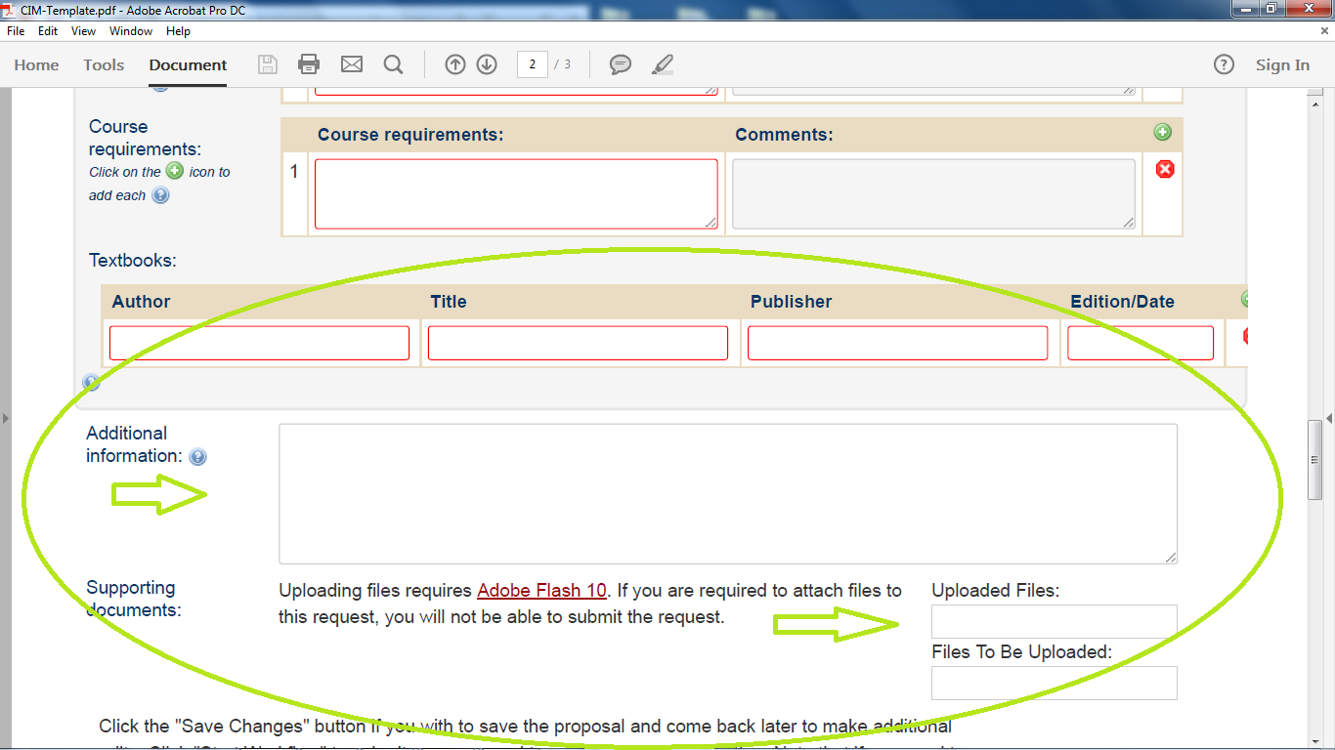

Slide 34
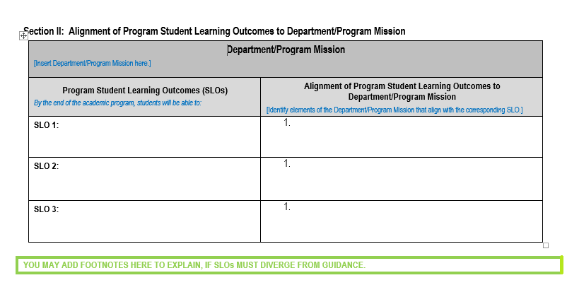

Slide 35
Evaluating SLOs 
Clearly explain the mechanisms of development from different theoretical perspectives.
Accurately define developmental change.
Accurately identify and describe theories and models which describe the developmental process.
Clearly articulate strengths and limitations in theories and approaches that explain, predict, and describe the developmental process.
Appropriately apply theoretical knowledge to in-depth investigation of a particular topic associated with development in childhood or adolescence.
Activity

Slide 36
On Your Own
Select 1-2 student learning outcome(s) from your syllabus.
Determine whether the SLOs are measurable as written.
  Do the SLOs contain all of the ABCCs?
Revise SLOs as needed so that all components (ABCCs) of selected SLOs are included and are measurable.
Pairs Check:
  Provide feedback to a colleague on the revised SLOs he/she has drafted – switch roles
Activity

Slide 37
Examples to Share…
Who will share his/her draft student-learning outcome and an improved version of the SLO?
Activity

Slide 38
Contact Information
Terry Senne, Director of Academic Assessment
  tsenne@twu.edu
  (940) 898-3029
Gray Scott, Assistant Director of Academic Assessment
grayscott@twu.edu
(940) 898-2327

Slide 39
Appendices

Slide 40
The Design-Down Approach to Constructing a Course
Always start with the end product (SLOs) in mind.
Consider the following questions to begin the process of constructing SLOs: What intended student learning is critical to program/course/lesson content knowledge? And, what will students be able to do with content knowledge gained?

Slide 41
How could the above SLO be restated?
Consider the following SLO:
  Clearly differentiate and apply early childhood theories.
    What taxonomy level is the action verb differentiate?
    What taxonomy level is the action verb apply?
    Are both action verbs needed? Why or why not?
Activity

Slide 42
Closing Thoughts
Core course proposal submissions
Course proposal submissions for Global Perspectives designation
TWU CIMS course proposal submission approval process
  “The buck stops here.” — Academic Assessment
  Course SLOs are reviewed first.
  If proposed course SLOs do not meet the TWU Guidelines as submitted, the course proposal will be sent back to the department for SLOs revision.
Comments for the good of the group

