Slide 1
Bursar’s Office

Slide 2

Office of the Bursar
Admissions/Registration Building
304 Administration Drive
Denton TX 76204
Phone: 940-898-3570
Fax: 940-898-3578
Email: payments@twu.edu
Window Hours: M-Thur, 9am – 4pm
Phone Hours: M-F, 8am – 5pm
www.twu.edu/bursar

Slide 3




What are Accepted Payment Methods?
Credit/Debit Cards Online Only - 2.95% addt’l fee
MasterCard/VISA
American Express
Discover
Personal Check (unless past-due balance)
Cash
Money Order/Cashier’s Check
WebCheck (ACH)
Financial Aid Awards

Slide 4
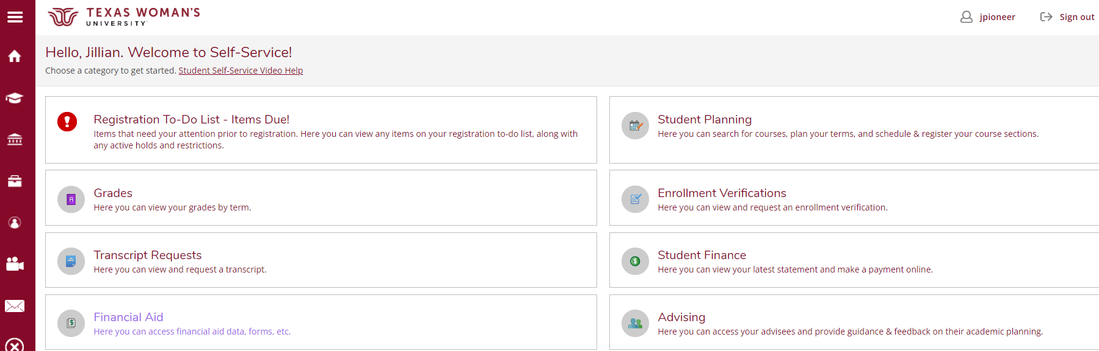
Where’s My Bill? Bills are not mailed>>access in Self-Service

Slide 5
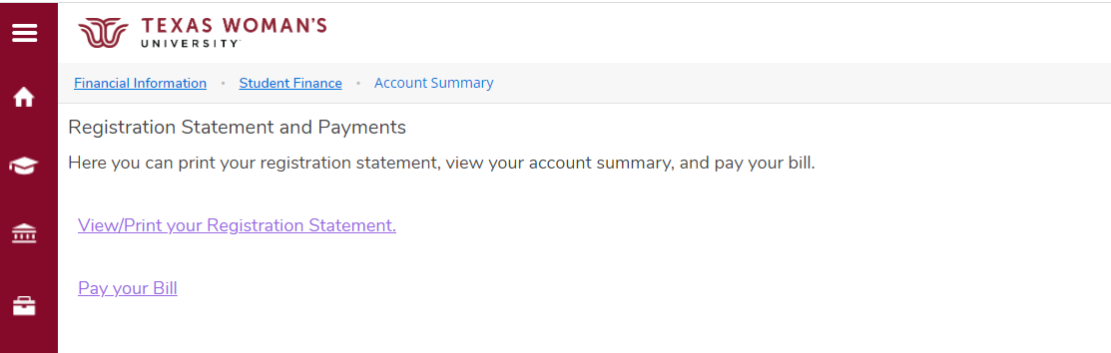
View Detailed Bill with Class Schedule

Slide 6
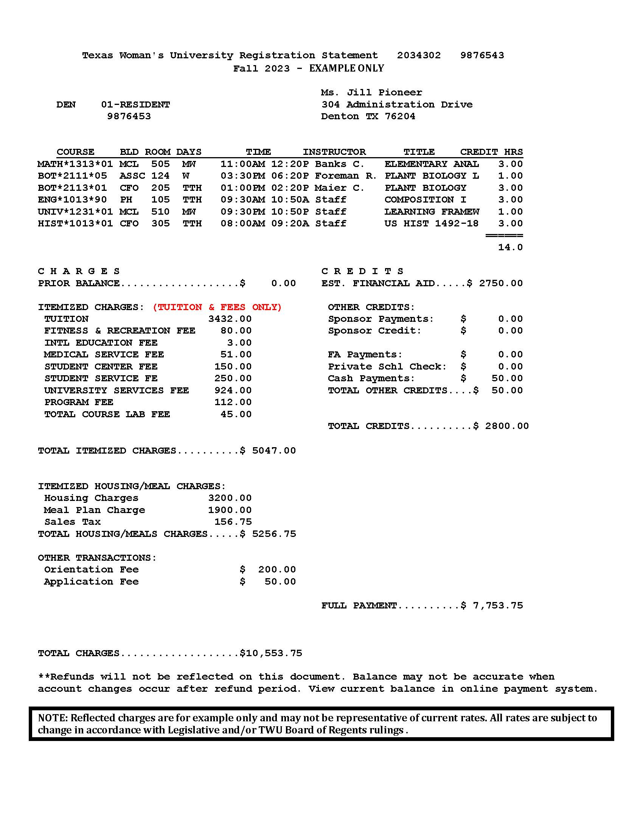
Fall 2025 – Example Only

Slide 7
Fall 2025 - Example Only
Student ID
Total hours

Slide 8
Fall 2025 Due Aug. 22

Slide 9
What are my Payment Options?
Payment in Full
Full payment must be received by posted payment deadline.
Installment Payment Plans(Fall/Spring)
Regular semester plan - 4 payments
Emergency plan – 3 payments
Summer plan different.

Slide 10
Fall 2025 Installment Plan
25% down payment required of remaining balance
$25 installment fee included
Accepted financial aid applied first
Three monthly payments:
Sept. 15 Oct. 15 Nov. 15

Slide 11
Fall 2025 Emergency Plan
Designed for students awaiting financial aid processing
No down payment when enrolling
$25 installment fee due upon enrollment
Balance in three monthly payments:
Sept. 15 Oct. 15 Nov. 15

Slide 12

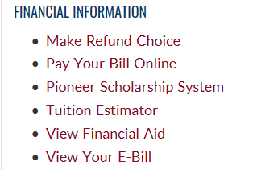
How do I get my refund? > In Portal select Make Refund Choice

Slide 13
Fixed vs Standard Tuition Credit Hour Rates
Students entering 2025-26 | Year 1 | Year 2 | Year 3 | Year 4
Fixed Plan | $288.88 | $288.88 | $288.88 | $288.88
Standard Plan | $238.00 | TBD | TBD | TBD
Students entering 2024-25
Fixed Plan | $288.88 | $288.88 | $288.88 | $288.88
Standard Plan | $238.00 | $238.00 | TBD | TBD
Students entering 2023-24
Fixed Plan | $288.88 | $288.88 | $288.88 | $288.88
Standard Plan | $238.00 | $238.00 | $238.00 | TBD
Students entering 2022-23
Fixed Plan | $267.41 | $267.41 | $267.41 | $267.41
Standard Plan | $234.00 | $238.00 | 238.00 | 238.00

Slide 14
WELCOME TO TWU!
Remember Fall Payment Deadline
is August 22!

